Slide 1
Measures of contraceptive availability in the retail sectors of Brazil, Dominican Republic, Guatemala, Honduras and Nicaragua
Presented by Peter Stephens, IMS Health

Slide 2
Executive Summary
Scope
Retail pharmacy supply of modern contraceptives in 5 countries – Brazil, Dominican Republic, Honduras, Guatemala, Nicaragua
Conclusions
Retail pharmacy remains an important source of modern contraceptive supply, although its contribution varies markedly by geographic region in each country
Retail pharmacy appears to complement public sector supply and subsidies, at least in Brazil and Nicaragua, but realistically only in wealthier areas.
Method mix in retail pharmacy differs across countries with Emergency Contraception showing the greatest variation.
No clear change in retail pharmacy supply can yet be associated with Zika infections at a National or State level:
More detailed geographic and longitudinal data from MoHs or PAHO may aid analysis (Brazil, Nicaragua)
Indications of change in EC, and possibly OC, in Guatemala – more time periods needed to confirm changes

Slide 3
Study Questions
How important is retail pharmacy as a source of modern contraceptive supply? | 1
What methods are sourced through retail pharmacy, which manufacturers are present and how does price vary by country? | 2
Do retail pharmacy sales vary by region, with what is that variation associated, and how does retail pharmacy relate to public sector supply? | 3
Does it appear that retail pharmacy sales have been affected by reports of Zika infection? | 4
Brazil
Dominican Republic
Guatemala
Honduras
Nicaragua

Slide 4
IMS Methodology
Retail pharmacy only
Wholesaler based + pharmacy panel data
Pharmaceuticals (+ condoms in Brazil only)

Slide 5
IMS data sourced from wholesalers supplemented by panel of pharmacies
Ethical volumes validated against manufacturer’s estimates on an annual basis
2014 validation | Under/Over† | Precision‡
Brazil | -1.2% | 99.1%
Dominican Republic | +1.9% | 73.5%
Guatemala | -1.1% | 83.5%
Honduras | -8% | 82.6%
Nicaragua | -7.2% | 75.1%
† Difference from manufacturer estimates
‡ Measure of distribution around difference from manufacturer estimates

Slide 6
IMS data sourced from wholesalers supplemented by panel of pharmacies
Ethical volumes validated against manufacturer’s estimates on an annual basis
2014 validation | Under/Over† | Precision‡
Brazil | -1.2% | 99.1%
Dominican Republic | +1.9% | 73.5%
Guatemala | -1.1% | 83.5%
Honduras | -8% | 82.6%
Nicaragua | -7.2% | 75.1%
† Difference from manufacturer estimates
‡ Measure of distribution around difference from manufacturer estimates
Prices:
Brazil: Ethical – Regulated prices at wholesaler level
Brazil: Condoms – Chain & Internet pharmacy sample
All other: Weighted average wholesaler transaction price; Guatemala & Brazil include VAT

Slide 7
Study Scope
How important is retail pharmacy as a source of modern contraceptive supply? | 1
What methods are sourced through retail pharmacy, what manufacturers are present and how does price vary by country? | 2
Do retail pharmacy sales vary by region, with what is that variation associated, and how does retail pharmacy relate to public sector supply? | 3
Does it appear that retail pharmacy sales have been affected by reports of Zika infection? | 4
Brazil
Dominican Republic
Guatemala
Honduras
Nicaragua

Slide 8
DHS† suggest up to a half of women source oral contraceptives from retail pharmacy
Up to one fifth of women source injectables there too
 | DHS
 | Pills | Injectables | Condoms | IUD
Brazil | - | - | - | -
Dominican Republic | 30.6% | 3.2% | 23.0% | -
Guatemala | 34.3% | 7.8% | 72.3% | -
Honduras | 49.3% | 19.8% | 53.9% | -
Nicaragua | 36.4% | 13.5% | 68.4% | 1%
Plus Emergency Contraception (EC) can be sourced from retail pharmacy in Brazil, Dominican Republic, Guatemala and Nicaragua (and public sector). In Honduras EC is prohibited. In Dominican Republic EC is legally available without prescription.
† DHS in Dominican Republic, Guatemala, Honduras. Nicaragua uses similar methodology, but carried out by MoH.

Slide 9
Sales volume of modern contraceptives through retail pharmacy is growing in all countries
 | CYP per 1000 women aged 15-49 | CYP growth (Yr 2014-Yr to June 2016) | USD change (Yr 2014-Yr to June 2016)†
Brazil | 268 | 6.4% | (-26%)/+9%†
Dominican Republic | 41 | 4.3% | 11.6%
Guatemala | 12 | 21.1% | 5.5%
Honduras | 26 | 2.3% | -1.1%
Nicaragua | 78 | 27% | 10.8%
† Brazil USD calculation based on MAT June 2015 vs MAT April 2016. Negative figure due to exchange rate fluctuations; At constant exchange rate as of June 2016, growth is +9%

Slide 10
Comparisons with available Gov’t/social security supply confirms the role of retail pharmacy
% retail pharmacy | Injectables | Hormonal Pills | IUD
MOH, Guatemala | 6% | 29% | 29%
IPSS, Nicaragua | 81% | 59% | 22%
For every 100 pills supplied by the MoH in Guatemala, retail pharmacy supplies 29 more
The IPSS covers 13% of the population in Nicaragua. For every 100 injectables reimbursed by the IPSS, retail pharmacy dispenses 81.

Slide 11
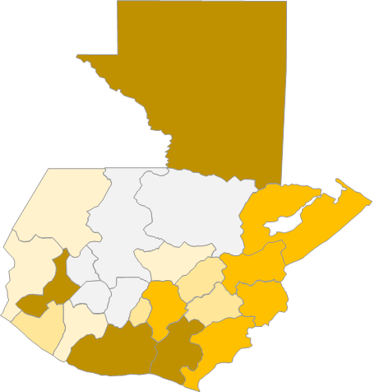
The importance of retail pharmacy supply varies by geographic region
SUPPLY BY STATE OR DEPARTMENT
CYP per 1000 women aged 15-49 | Mean | Minimum | Maximum
Brazil | 268 | 68.5 | 1168.7
Dominican Republic | 41 | - | -
Guatemala | 12 | 1.2 | 28.9
Honduras | 26 | 0.4 | 228
Nicaragua | 78 | 15.3 | 106.4
Guatemala, CYP Quintiles by Department

Slide 12
Study Scope
How important is retail pharmacy as a source of modern contraceptive supply? | 1
What methods are sourced through retail pharmacy, what manufacturers are present and how does price vary by country? | 2
Do retail pharmacy sales vary by region, with what is that variation associated, and how does retail pharmacy relate to public sector supply? | 3
Does it appear that retail pharmacy sales have been affected by reports of Zika infection? | 4
Brazil
Dominican Republic
Guatemala
Honduras
Nicaragua

Slide 13
Method mix through retail pharmacy differs by country (Year to June 2016)
Volume CYP | OC | Injectable (monthly) | Injectable (3 monthly) | EC
Brazil | 78% | 10% | 4% | 6%
Dominican Republic | 53% | 6% | 1% | 39%
Guatemala | 46% | 39% | 5% | 7%
Honduras | 37% | 44% | 18% | -
Nicaragua | 23% | 50% | 21% | 5%

Slide 14
Wholesaler prices to retail pharmacy varies by country – as of Year to June 2016
In Dominican Republic, EC wholesaler price lower than OC
Trade prices ($USD per CYP) | Average | Inj (3) | Inj (1) | OC | EC | V.Ring | Patch
Brazil† | 52 | 23 | 37 | 56 | 67 | 206 | 235
DR | 75 | 59 | 102 | 95 | 50 | 295 | -
Guatemala† | 132 | 63 | 66 | 175 | 277 | 373 | 378
Honduras | 101 | 29 | 54 | 192 | - | 336 | 350
Nicaragua | 69 | 8 | 38 | 106 | 474 | 239 | 273
† Includes sales tax of ~18%
Notes:
Weighted average CYP price per USD decrease since 2014 in Guatemala (-13%), Honduras (-3%) and Nicaragua (-12%).
Monthly injectables price decrease since 2014 in Dominican Republic (-6%), Honduras (-10%), Guatemala (-15%) and Nicaragua (-6%).
Price trends for other methods vary by country.

Slide 15
Retail pharmacy supply is “mildly concentrated”
And new entrants may be unlikely
 | HHI‡ | No. MNFs† >10% CYP¥ | Total No. MNF¥ | Value
Brazil | 840 | 2 | 50†/30 | $682m
Dominican Republic | 1,193 | 3 | 31 | $8.4m
Guatemala | 1,528 | 2 | 20 | $6.6m
Honduras | 1,990 | 4 | 17 | $5.8m
Nicaragua | 1,868 | 3 | 18 | $4.9m
‡ Herfindahl Index – a measure of concentration
† With condoms/without condoms
¥ MNFs =Manufacturers = marketing authorisation holders
Bayer ~45% of CA and DR
Market size value not large, exc. Brazil
Even in Brazil only 30 manufacturers
Majority tend to be local and/or small

Slide 16
Study Scope
How important is retail pharmacy as a source of modern contraceptive supply? | 1
What methods are sourced through retail pharmacy, what manufacturers are present and how does price vary by country? | 2
Do retail pharmacy sales vary by region, with what is that variation associated, and how does retail pharmacy relate to public sector supply? | 3
Does it appear that retail pharmacy sales have been affected by reports of Zika infection? | 4
Brazil
Dominican Republic
Guatemala
Honduras
Nicaragua

Slide 17
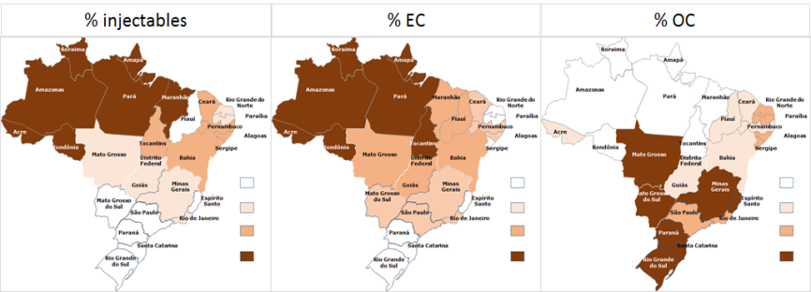
Method mix by retail pharmacy differs by geographic region
Retail pharmacy supplies relatively more injectables and EC in poorer areas of Brazil

Slide 18
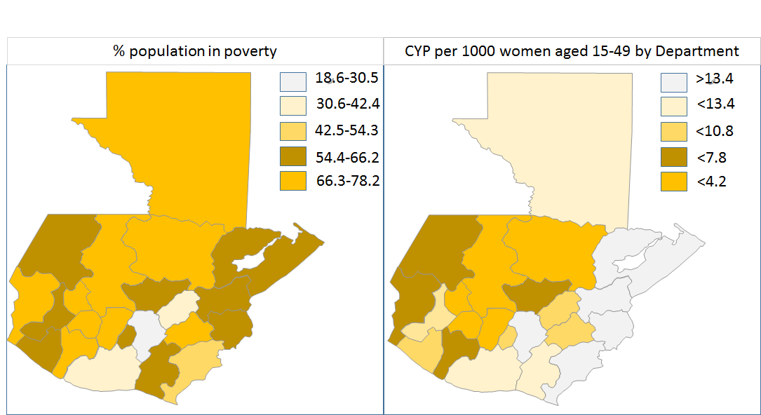
In Guatemala too, retail pharmacy focuses more on wealthy areas

Slide 19
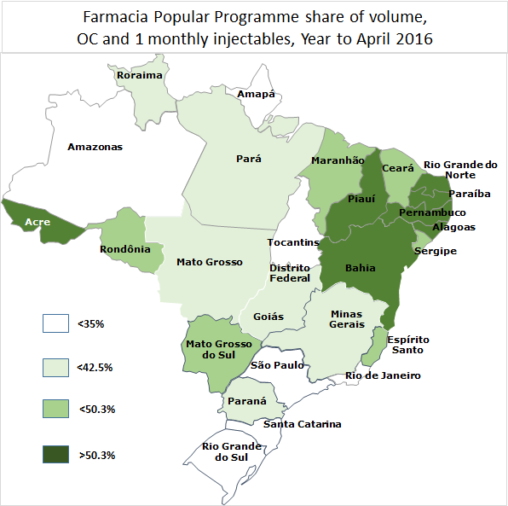
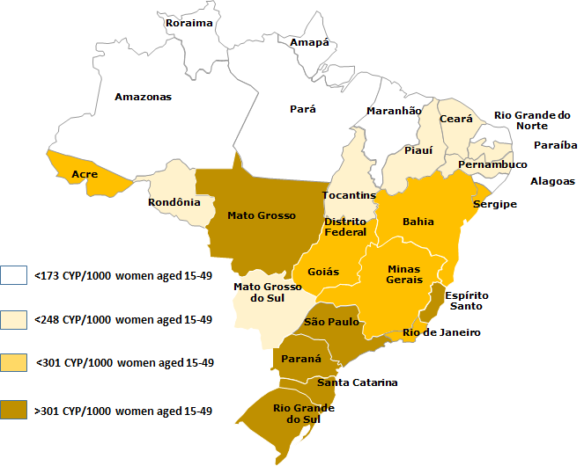
In Brazil, retail pharmacy supply is complementary to public sector subsidies (Farmacia Popular)
Total CYP by State
The deeper the yellow the more volume is going through retail pharmacy
The deeper the green the higher the share of products able to be dispensed under FP†
† Measured on OC and Inj. Monthly. All 3 monthly forms theoretically reimbursable on FP

Slide 20
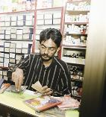
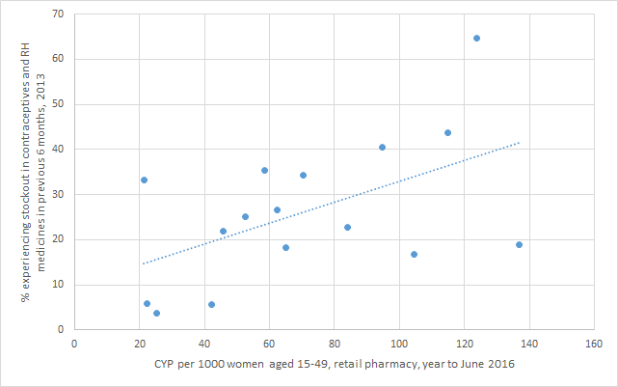
In Nicaragua, retail pharmacy supply appears to complement public sector supply at a Departmental Level
More Stockouts, 2013 survey
Each dot is a region in Nicaragua
More retail pharmacy supply (CYP per 1000 women), Yr to June 2016

Slide 21
Study Scope
How important is retail pharmacy as a source of modern contraceptive supply? | 1
What methods are sourced through retail pharmacy, what manufacturers are present and how does price vary by country? | 2
Do retail pharmacy sales vary by region, with what is that variation associated, and how does retail pharmacy relate to public sector supply? | 3
Does it appear that retail pharmacy sales have been affected by reports of Zika infection? | 4
Brazil
Dominican Republic
Guatemala
Honduras
Nicaragua

Slide 22
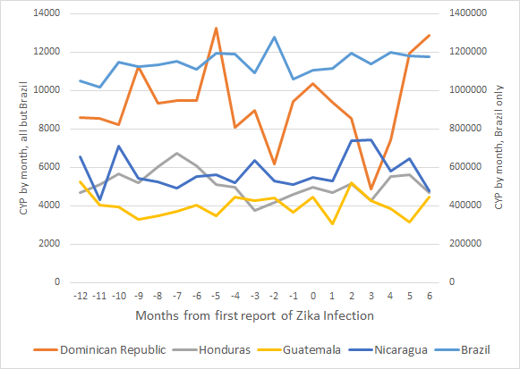
No clear uplift in national pharmacy sales post Zika
First report of Zika infection

Slide 23
State level analysis do not reveal an effect either
In Brazil Pernambuco reported as having one third of cases of microcephaly, Bahia the most Zika cases

Slide 24
State level analysis do not reveal an effect either
In Brazil Pernambuco reported as having one third of cases of microcephaly, Bahia the most Zika cases

Slide 25
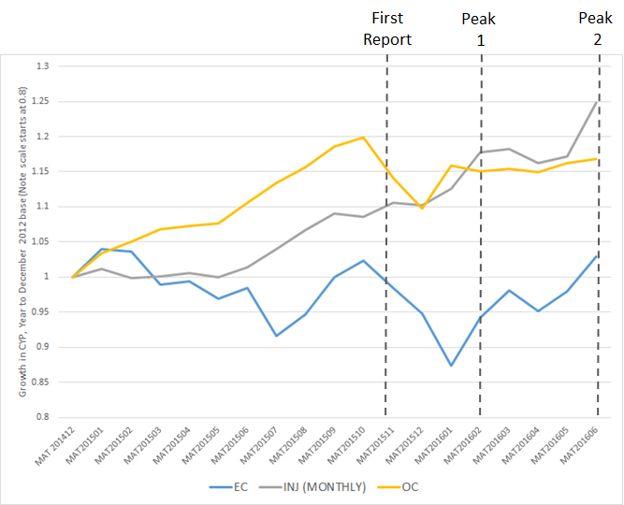
Possible effect at method level in Guatemala
Possible reversal of decline in EC?

