Slide 1
Using real-time data and technology to track and supply critical health commodities in Pakistan during COVID-19
Dr. Muhammad Tariq, GHSC-PSM Country Director September 2020
Photo: Lan Andrian

Slide 2
Health and humanitarian challenges necessitate reliable data for decision-making
With the support of the USAID Global Health Supply Chain Program-Procurement and Supply Management (GHSC-PSM) project, the Government of Pakistan has used its mature logistics management information system (LMIS) to plan for and deliver critical COVID-19 supplies.
Much of the is work has been coordinated through the Ministry of National Health Services, Regulations and Coordination (MoNHSR&C) and National Disaster Management Authority (NDMA).

Slide 3
The evolution of LMIS in Pakistan
One system, one database – multiple interface variants
Contraceptive LMIS | Vaccine LMIS | Khyber Pakhtunkhwa Medicine LMIS | Sindh & Punjab HLMIS | MoNHSR&C LMIS | NDMA Proc & LMIS | Balochistan LMIS
All of these systems feed data from across the country into a single database for analysis and decision-making
UNICEF HLMIS for MNCH
LMIS
For Medicines
(Punjab, KP)
Govt. self-reliance for commodity procurement
2020
$100 M govt. financing
2019
Contraceptive
& Vaccine
LMIS
2018
UNICEF funded HLMIS for MNCH in Sindh and Punjab
COVID-19 TSMIS
COVID-19 LMIS
COVID-19 Procurement Module
Sindh COVID-19 training dashboard
LifeLine ICT Inventory System
2015-17
SMS / email alerts and notifications
Stock Optimization Intelligence
Medicine LMIS for KP
Medicine LMIS for Punjab provincial stores
Interfacing with vertical systems
Business Intelligence
Forecasting Module
Action based Executive Dashboard
2011-14
Demand Planning
Supply Planning
Consumption Module
Warehouse Mgmt.
Analytics & Dashboards
3
Notes:
Pakistan’s health supply chain Logistics and Management Information System is a mature open source technology which evolved over a decade through the incorporation of feedback from key users and stakeholders. Managed by the USAID Global Health Supply Chain – Procurement and Supply Management Project, the LMIS is 100% government owned, and was chosen to serve as the integrated platform for Pakistan’s Ministry of National Health Services, Regulation and Coordination body, and all other funders supporting procurement and delivery of COVID-19 PPE across the country.
Before the system implementation in Pakistan, public health commodities were funded by partners or donors, and the government had little-to-no data visibility which limited its ability to allocate funds. After supporting consistent data reporting and high data quality, the GHSC-PSM project has now instituted advanced analytics tools: These tools now provide insights to support evidence-based decisions and have become the basis for planning, procurement, and funds allocation.
The four major tools provided in Pakistan LMIS include: Demand and Planning Intelligence, Control Tower supported by Machine Learning Algorithms, Pivot BI Tool and an Executive Dashboard with unified information on historic trends, and vertical supply chain programs.
The application has evolved to capture real-time inventory data and product pipeline information to enable it to act as a critical supply management tool; whereby forecasting, quantification, pipeline monitoring and stock management functions are being performed by various Pakistani government departments based on LMIS data. In addition, the system’s flexible architecture is able to support all supply chain management of family planning, medicines, and vaccines, supply chains, including emergency supplies.
The incorporation of BI and ML tools into Pakistan’s LMIS maximizes the utility of the reliable data collected by the system, enabling decision makers to take action on the following:
Allocate funds based on detailed needs assessment
Optimize stock levels, reduced loss on expired stock, and flexible use of inventories for better health services.
Pakistan is only one of two middle-income countries to have achieved integrated status in Supply Chains’ maturity due to this implementation of Pakistan LMIS. The system has matured from serving as a source of quality and timely data, and is now capable of translating this gathered data into useful and actionable information for decision makers.

Slide 4
Rapid response to COVID-19 data visibility needs
Travelers Surveillance MIS
(TSMIS)
1
NDMA Procurement & LMIS
MoNHSR&C
LMIS
5
2
GHSC-PSM
Govt. of Pakistan
4
3
Sindh COVID Training Dashboard
COVID-19 Forecasting Calculator
4
Notes:
TSMIS = Implemented at 8 Entry Points Recorded Data on 1700 Flights Screened Nearly 14500 Travelers
Trained 75 Government Staff
NDMA LMIS = 265 Purchase Orders (7.3Billion), Stock Received 417 (200 Ventilators GIS tracking)
MoNHSR&C & LMIS = 110+ Supplies, 10 Major Hospitals
FASP Calculator = 71 Countries , 4 Languages , 5,33I trained I+ Solutions
Sindh COVID-19 Training Dashboard = 1100+ records

Slide 5
Systems allow Pakistan to easily report on international standard health supply chain indicators (Track FP20 analytics, PPMR, and Contraceptive Security Index)
This data is open access: http://lmis.gov.pk/track20.php
Pakistan LMIS automatically generates Track FP2020 analytics based on the government and NGO reported data

Slide 6
Pakistan’s financing of health commodities ranks 2nd highest among countries in the region
Family Planning Commodity Financing & Procurement
National financing
USAID financing
Provincial government financing
Use of the right technology for data collection and analytics has allowed the Government of Pakistan to allocate funds for better public health
$ 5 M on average per annum
$ 108 M
$ 130 M
2001 - 09
2010 - 14
2015 – 20
USAID support
Pakistan self-reliance

Slide 7
Improving the capabilities of Pakistan’s LMIS
Context / Motivation
Methodology
Pivot BI
SC Control Tower
1
Executive Dashboard
2
Demand Planning Predictor
Results
Evidence-based decision making
3
Use of Technology
Achieved SC
Integrated Status

Slide 8
Advanced analytics tools track critical health commodities and supplies
Control Tower |  | PIVOT BI Tool
Past six months and current month’s data visibility Predicts and projects next six months’ demand and supply; using algorithms. |  | Free hand tool for business intelligence Decision makers can design data views as per their requirements. Data can be exported to Excel
Executive Dashboard |  | Demand Intelligence
360 degrees analytics for executive to view stock at central warehouse, district stores and health facilities. System algorithms suggest the quantity need to be procured, based on the consumption data Drill down option to view granular information Allows to communicate decision via SMS and emails |  | Demand planner can view and make demand plan: historic data Current stock on hand Requisition quantity and justification provided by the initiator Stock available at supplier warehouse Adjust requisition quantity

Slide 9
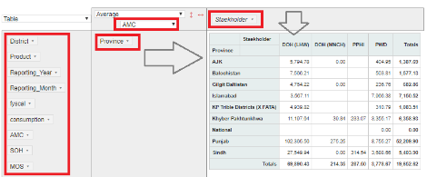
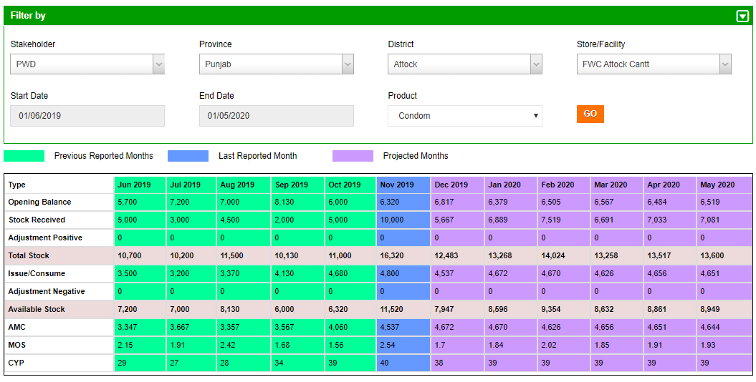
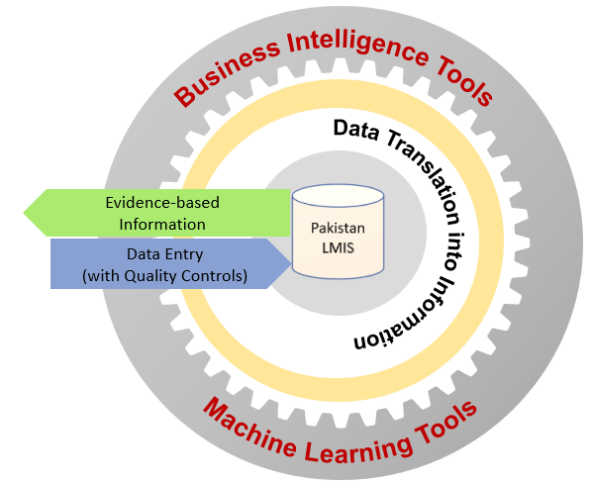
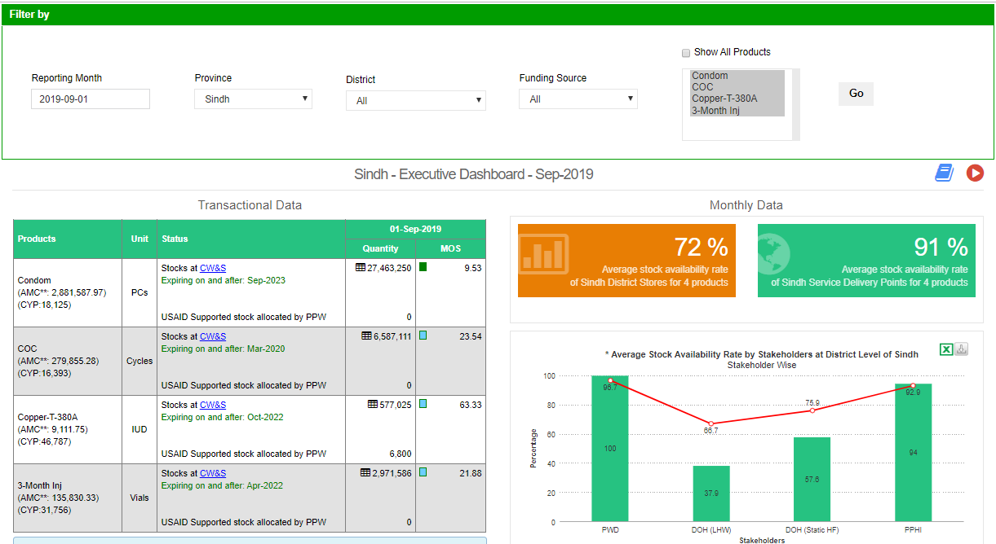
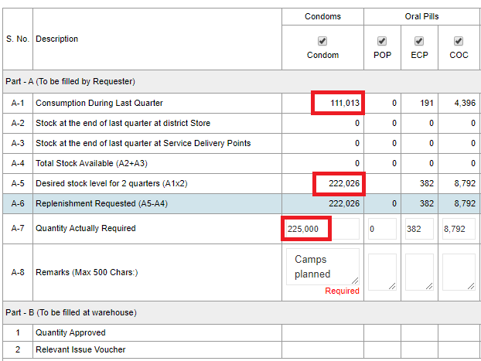
Analytics provide more power to the health services industry
Control Tower
PIVOT BI
Executive Dashboard
Demand Intelligence

Slide 10
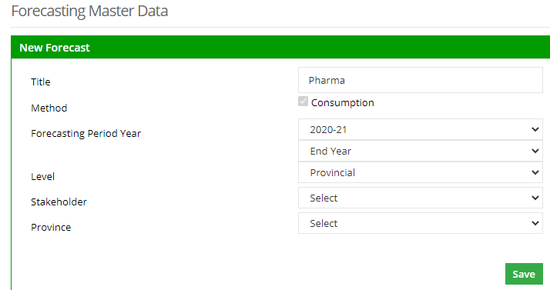
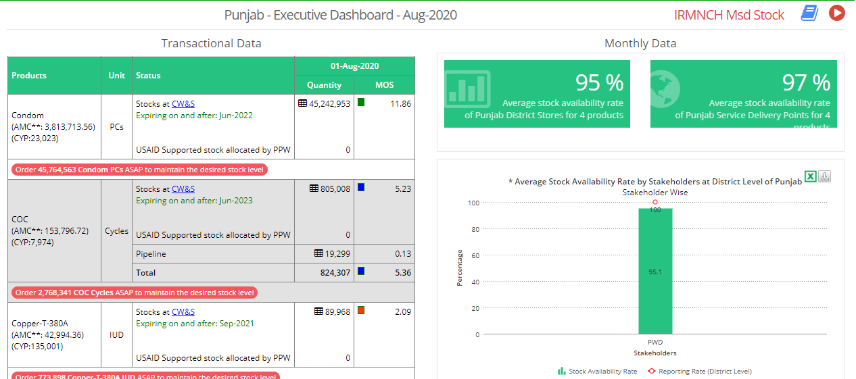
Advanced analytics provide more power to the pharma industry
FASP MODULE
FASP
Procurement
PROCUREMENT MODULE
LMIS
Demand
Inventories visibility
Financial planning
Production planning
EXECUTIVE DASHBORD
GS1 tracking – secondary & tertiary levels
Supply planning
Consumption visibility
Notes:
The Government owned Contraceptive LMIS, hosted at the Ministry of IT/National Telecommunication, containing multi-tier inventories and consumption data is enriched with executive dashboards enabling the policy makers to take informed decisions. The system can be interfaced with the industry to forecast the production lines. The project has worked on > $330m Family Planning Business forecast from 2020-30, with the potential business of $209m alone for internationally procured commodities (based on LMIS data).

Slide 11
Lessons learned
Pakistan’s open source LMIS business model was an ideal technology to meet the needs of COVID-19 visibility
Use existing IT, human resources, and implementation partners to deploy new non-digitized information needs and systems
Equip your decision-makers with advanced analytical tools; translating data into useful information is pivotal for evidence-based decision-making
Encourage open source technology; use financial gains to procure commodities and HR capacity building
Systems for Health Logistics, Health Services, Disease Surveillance and Industry should be on a singular technology platform to allow collaboration and ultimately help communities across the country

Slide 12
USAID GLOBAL HEALTH SUPPLY CHAIN PROGRAM
Procurement and Supply Management
MTariq@chemonics.com
Abstract: Using Real-Time Data and Technology to Track and Supply Critical Health Commodities in Pakistan During COVID-19
National Science and Technology Park (NSTP)
NUST, H12, Islamabad, 44000, Pakistan
+92 333 5555 291

