Slide 1
Improving Family Planning Stockout Data Quality and Reporting
Part 2: Understanding How to Apply the Active Site Rule

Slide 2
To navigate between sections, use the links below
Section 1: Family planning methods with one versus multiple products
How the Active Site Rule applies to the stockout rate calculation for various family planning methods and products.
Section 2: Annual and Quarterly Stockout Rates
How the application of the rule changes during annual reporting and quarterly reporting; which months are most important for determining whether a site is active.
Section 3: Missing data points
What data points, and during which months, are most critical for applying the active site rule during quarterly reporting.
Annex: Limitations and Special Situations
While the Active Site Rule provides a consistent approach that uses available data to determine which sites are currently offering a family planning product, this section highlights its limitations, such as data quality, and situations in which it would not necessarily apply.

Slide 3
Section 1:
Family planning methods with one versus multiple products
This segment will first discuss differences in annual and quarterly reporting for family planning methods and then demonstrate how these are affected by the Active Site Rule.

Slide 4
Family planning methods with one versus multiple products
Some family planning methods are available in different product types and formulations, which may vary by country. For a product like male condoms, the stockout rate calculation considers this a single-product method.
But for other methods, such as injectables, countries may offer one or multiple product types. The Active Site Rule must consider whether there are one or multiple product types for the method.

Slide 5
Family planning methods with one versus multiple products
Family Planning Methods
 | ANNUAL REPORTING | GHSC QUARTERLY
 | Injectable Hormonal Contraceptives | Injectable Contraceptives
 | Depot Medroxyprogesterone Acetate 104 mg/ 0.65 mL | Depot Medroxyprogesterone Acetate 104 mg/ 0.65 mL
 | Depot Medroxyprogesterone Acetate 150 mg Vial | Depot Medroxyprogesterone Acetate 150 mg Vial
 | Norethisterone enanthate | Norethisterone enanthate
 | Implantable Hormonal Contraceptives | Implantable Contraceptives
 | Etonogestrel 68 mg/rod, 1 rod Implant | Etonogestrel 68 mg/rod, 1 rod Implant
 | Levonorgestrel 75mg/rod, 2 rod Implant | Levonorgestrel 75mg/rod, 2 rod Implant
 | Oral Hormonal Contraceptives | Oral Contraceptives
 | Levonorgestrel/Ethinyl Estradiol 150/30 mcg + Fe 75 mg, 28 Tablets/Cycle | Levonorgestrel/Ethinyl Estradiol 150/30 mcg + Fe 75 mg, 28 Tablets/Cycle
 | Levonorgestrel/Ethinyl Estradiol 150/30 mcg 28 Tablets/Cycle | Levonorgestrel/Ethinyl Estradiol 150/30 mcg 28 Tablets/Cycle
 | Progestin-only pills (Levonorgestrel 30 mcg 35 Tablets/Cycle) | Progestin-only pills (Levonorgestrel 30 mcg 35 Tablets/Cycle)
 | Emergency Oral Contraceptives (Not reported in annual stockout rate) | Emergency Oral Contraceptives
 |  | Levonorgestrel 0.75 mg, 2 Tablets
 |  | Levonorgestrel 1.5 mg, 1 Tablet
 | Male condoms | Male condoms
 | Female condoms | Female condoms
 | Calendar-based methods | Calendar-based methods
 | Intrauterine devices | Intrauterine devices
This table demonstrates the family planning methods required to be reported for the average (annual) stockout rate and the Global Health Supply Chain (GHSC) quarterly stockout rate.

Slide 6
Family planning methods with one versus multiple products
There are several tracer family planning methods which may have two or three products offered by a country. These include:
Injectable Contraceptives Implantable Contraceptives
Combined Oral Contraceptives/Oral Hormonal Contraceptives Emergency Oral Contraceptives (quarterly stockout rate only)
Note that slight differences apply in how products and methods are categorized and reported for the average (annual) stockout rate and the Global Health Supply Chain (or GHSC) quarterly stockout rate.

Slide 7
Family planning methods with one versus multiple products
Additionally, annual reporting is at the method level only, while quarterly reporting is both at the method and product level for applicable methods.

Slide 8
Family planning methods with one versus multiple products
Using the Active Site Rule to calculate the stockout rate for methods with multiple products
When there are multiple products offered for a method, the Active Site Rule for a health facility must first be assessed for each of the products separately before determining whether the health facility is inactive for the family planning method.
If no products within a method are active (offered), the health facility is inactive for that method. That method is not “offered” at the facility.
For example, if a health facility actively offers the injectable Norethisterone enanthate, it is considered an active site for offering injectables.

Slide 9
Family planning methods with one versus multiple products
Let’s take implantable contraceptives as an example. When applying the Active Site Rule and determining which facilities are active and inactive, there are several scenarios to consider for a given health facility. Recall that sites
are determined to be ‘inactive’ for a product if the product has not been in stock, issued to clients, or ordered by the facility for the previous consecutive 12 months.

Slide 10
Family planning methods with one versus multiple products
Scenario 1. Both 1-rod and 2-rod implants are ‘active’ for the site. The site is ‘active’ for implantable contraceptives.
Scenario 2. 1-rod implants are ‘active’ for the site, but 2-rod implants are inactive. The site is still ‘active’ for implantable contraceptives.
Scenario 3. 1-rod implants are ‘inactive’ for the site, but 2-rod implants are ‘active’. The site is ‘active’ for implantable contraceptives.
Scenario 4. Both 1-rod implants and 2-rod implants are ‘inactive’ for the site. The site is therefore ‘inactive’ for implantable contraceptives and must be removed from the numerator and denominator of the stockout rate calculation for implantable contraceptives.
For methods that only have a single product reported, if that product is inactive, the site is inactive for that method.

Slide 11
Family planning methods with one versus multiple products
Note that for methods that may have three products offered in the country, such as injectable contraceptives or oral hormonal
contraceptives, there are more combinations, but the same principle holds: as long as at least one product is active at a site, the site is active for the family planning method and does not get removed from the numerator or denominator when calculating that method.

Slide 12
Family planning methods with one versus multiple products
FACILITY A
FACILITY D
FACILITY G
Offers: Both 1-rod and 2-rod implants Reported: 10 units of 1-rod and 20 units of 2-rod implants
Result: Not stocked out of implants
Offers: Both 1-rod and 2-rod implants Reported: 30 units of 1-rod implants and 0 units of 2-rod implants
Result: Not stocked out of implants
Offers: 2-rod implants only
Reported: 5 units in stock
Result: Not stocked out of implants
FACILITY H
FACILITY B
FACILITY E
Offers: 2-rod implants only Reported: 0 units in stock Result: Stocked out of implants
Offers: Both 1-rod and 2-rod implants Reported: Did not report on 1-rod implants, 0 units of 2-rod implants Result: Stocked out of implants
Offers: 1-rod implants only Reported: 0 units in stock Result: Stocked out of implants
FACILITY F
FACILITY C
Offers: 1-rod implants only
Reported: 15 units in stock
Result: Not stocked out of implants
Offers: Both 1-rod and 2-rod implants Reported: 0 units of both products this month
Result: Stocked out of implants

Slide 13
Family planning methods with one versus multiple products
In the previous example of implantable contraceptives, the formula for arriving at the stockout rate would be the following:
Facility B + Facility C + Facility E + Facility H
Facility A + Facility B + Facility C + Facility D + Facility E
+ Facility F + Facility G + Facility H
= 50% stockout rate for implantable contraceptives in month X

Slide 14
Section 2:
Applying the Active Site Rule
for Annual and Quarterly Stockout Rates
Now that we have reviewed steps to apply the Active Site Rule and calculate the stockout rate for a single point in time for methods with one or multiple products offered, let’s look at how application of the rule changes for one quarter versus the average (annual) stockout rate.

Slide 15
Applying the Active Site Rule for Annual and Quarterly Stockout Rates
As we calculate, method-by-method, both the quarterly and annual stockout indicators, we must exclude any sites that were deemed inactive because they did not have any units in stock, issued, or ordered at any point in the past 12 consecutive months.
JAN
FEB
MAR
APR
MAY
JUN
JUL
AUG
SEP
OCT
NOV
DEC

Slide 16
Applying the Active Site Rule for Annual and Quarterly Stockout Rates
When applying the Active Site Rule in quarterly reporting, go back 12 months starting at the middle month of the quarter, which is May in this example.
Fiscal Year Q3 Example:
JUN Y1
JUL Y1
AUG Y1
SEP Y1
OCT Y2
NOV Y2
DEC Y2
JAN Y2
FEB Y2
MAR Y2
APR Y2
MAY Y2
JUN Y2

Slide 17
Applying the Active Site Rule
for Annual and Quarterly Stockout Rates
The Active Site Rule: Quarterly Reporting
Once the inactive sites have been removed, use the standard stockout rate formula for quarterly reporting. As we’ve demonstrated in this series, the denominator to the right refers to active sites.
Formula used in the quarterly stockout rate indicator (Fiscal Year Q3 Example) :
Number of facilities stocked out of product x in May
Number of facilities that reported on product x in May
JUN Y1
JUL Y1
AUG Y1
SEP Y1
OCT Y2
NOV Y2
DEC Y2
JAN Y2
FEB Y2
MAR Y2
APR Y2
MAY Y2
JUN Y2

Slide 18
Applying the Active Site Rule for Annual and Quarterly Stockout Rates
The Active Site Rule: Annual Reporting
The Active Site Rule plays out slightly differently when calculating the average annual stockout rate. The 12-month period used in the application of the rule is the same as the reporting period.
OCT NOV DEC JAN FEB MAR APR MAY JUN JUL AUG SEP

Slide 19
Applying the Active Site Rule for Annual and Quarterly Stockout Rates
Calculating the USAID average (annual) stockout rate indicator
For all Service Delivery Points (SDPs) offering method X:
Numerator:
# SDPs stocked out for month 1 +
# SDPs stocked out for month 2 +
# SDPs stocked out for month 3 +
# SDPs stocked out for month 4 +
# SDPs stocked out for month 5 +
# SDPs stocked out for month 6 +
# SDPs stocked out for month 7 +
# SDPs stocked out for month 8 +
# SDPs stocked out for month 9 +
# SDPs stocked out for month 10 +
# SDPs stocked out for month 11 +
# SDPs stocked out for month 12
Denominator:
# SDPs that reported for month 1 +
# SDPs that reported for month 2 +
# SDPs that reported for month 3 +
# SDPs that reported for month 4 +
# SDPs that reported for month 5 +
# SDPs that reported for month 6 +
# SDPs that reported for month 7 +
# SDPs that reported for month 8 +
# SDPs that reported for month 9 +
# SDPs that reported for month 10 + # SDPs that reported for month 11 + # SDPs that reported for month 12
Refer to slide 12 for information on how to determine if an SDP is stocked out of a method (e.g. “method x” in formula above).

Slide 20
Section 3:
How to apply the rule when there are missing data points
?
Types of missing data:
Non-reporting facilities
Incomplete stock reports

Slide 21
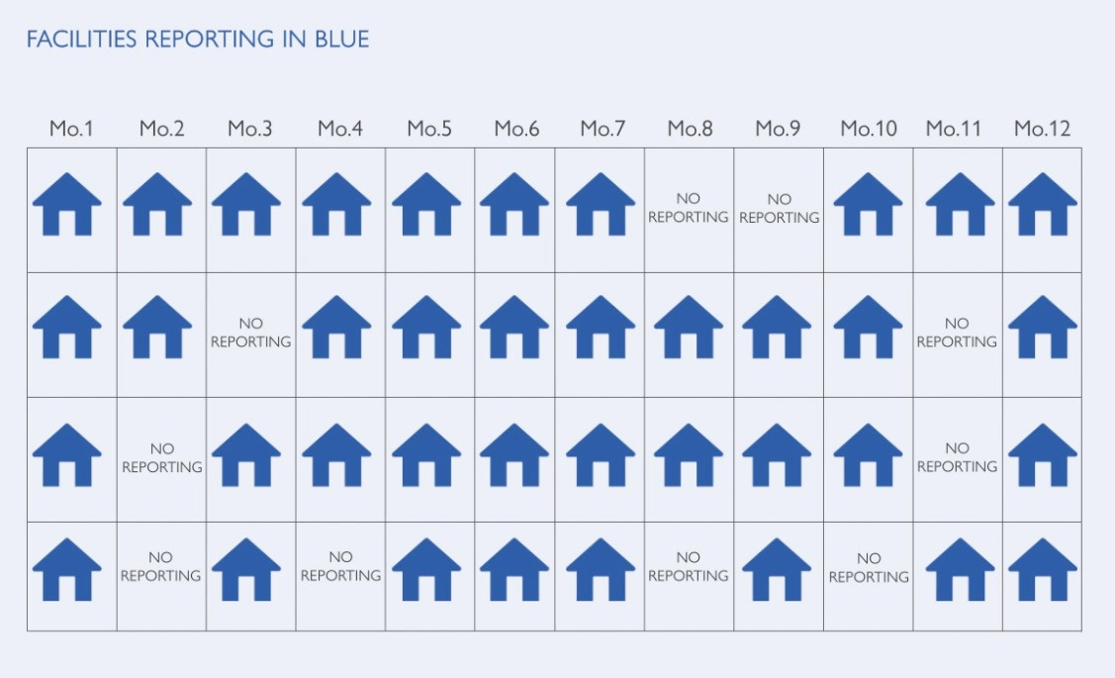
How to apply the rule when there are missing data points
Non-reporting facilities
Annual: Use available monthly data to apply
Active Site Rule (see slide 18)
Quarterly: Use available monthly data to apply Active Site Rule which must include the quarterly reporting month (see slide 17)

Slide 22
How to apply the rule when there are missing data points
Incomplete stock reports
?
Types of incomplete stock data:
Stock on hand/physical count/ending balance
Quantity of stock issued/dispensed
Average monthly consumption
Quantity of stock ordered

Slide 23
How to apply the rule when there are missing data points
Addressing incomplete stock reports for the quarterly stockout rate
For the quarterly stockout rate, there are two main considerations when stock reports are incomplete due to missing data points.
For example, if the stock on hand/ending balance is missing in one or more months, a non-zero amount of stock issued or stock ordered, or a non-zero average monthly consumption rate in any of the months is enough to determine that the facility is active.
1. If the stock on hand/ending balance is missing for the reporting month, this facility cannot be included in the stockout rate calculation.
Also note that while some other data elements may be missing for the reporting month or other months, stock on hand/ending balance is all that is needed to calculate the stockout rate.
2. When applying the active site rule for quarterly reporting, if there are missing data elements across the 12-month period, any of the data elements listed on slide 22 can be used to determine if the facility is active.

Slide 24
How to apply the rule when there are missing data points
Addressing incomplete stock reports for the annual stockout rate
For the average (annual) stockout rate, use available data points to assess the Active Site Rule
?

Slide 25
How to apply the rule when there are missing data points
Missing data exception for countries with less frequent reporting
Missing data is a more significant constraint for countries that report to their LMIS on a quarterly basis. The following slide will explain how to apply the Active Site Rule in such cases.

Slide 26
How to apply the rule when there are missing data points
Average (annual) Stockout rate for countries with quarterly LMIS reporting
Facility A has reported on method x during Q1 and at least two other quarters
(Q2 and Q3), so it can be assessed for the
Active Site Rule.
Quarter 1
Quarter 2
Quarter 3
Quarter 4

Slide 27
How to apply the rule when there are missing data points
Quarterly stockout rate for countries with quarterly LMIS reporting
Facility A has reported on method x during Q1, Q2 and during the reporting quarter (Q3), so can be assessed for the Active Site Rule and included in the quarterly stockout rate.
Quarter 1
Quarter 2
Quarter 3
Quarter 4
Q3: Reporting quarter

Slide 28
Annex: Limitations/Special Situations
Although the Active Site Rule provides a consistent approach that uses available data to determine which sites are currently offering a family planning method, there are some situations that it may not capture and other limitations to keep in mind.

Slide 29
Annex: Limitations/Special Situations
JAN
FEB
MAR
APR
MAY
JUN
JUL
AUG
SEP
OCT
NOV
DEC
Health facilities that maintain a small quantity of a product in stock for 12 months or more but do not dispense it, often due to low demand and/or lack of trained providers, would still be considered active according to the Active Site Rule.

Slide 30
Annex: Limitations/Special Situations
Poor data quality coming from an LMIS or HMIS, particularly missing data, could distort stockout rates, most likely showing artificially reduced stockout rates if distortion occurs.

Slide 31
Annex: Limitations/Special Situations
JAN
FEB
MAR
APR
MAY
JUN
JUL
AUG
SEP
OCT
NOV
DEC
In the absence of additional country information on a site's status, a site that becomes inactive takes 12 months to be classified as such under the Active Site Rule.

Slide 32
Annex: Limitations/Special Situations
Health program goals may differ from supply chain goals. For those who are more focused on access to family planning methods for clients in the country, or on which sites should be offering a method, this rule that narrows the focus on currently active sites might not be as useful.

Slide 33
Annex: Limitations/Special Situations
The Active Site Rule is one way to make use of available data to better understand the stock situation of family planning methods in a country, and a consistent approach to USAID reporting. It is not the only way to measure or understand stockouts and is not a replacement for site visits or supervision, or a one-size-fits-all approach to stock management analysis.

Slide 34
Thank you
for watching this presentation on applying the Active Site Rule.

