Slide 1
Framework for Developing Malawi Digital Supply Chain Strategy and Architecture
Oct 2021

Slide 2
Agenda
Overview of Digital Supply Chain (DSC)
Malawi DSC Situation Analyses
Draft DSC Strategy
Draft DSC Architecture
Draft DSC Roadmap (Sample)
2
Notes:
Review RMS SCM initiative details
Review traceability strategy document

Slide 3
Overview of Digital Supply Chain

Slide 4
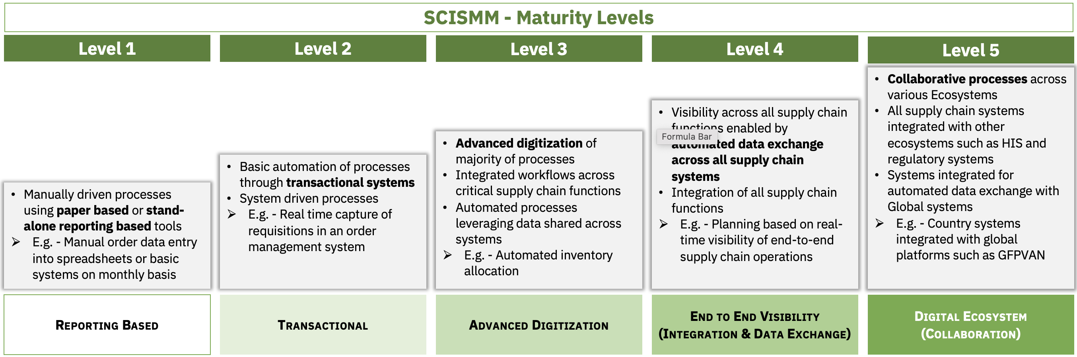
What is Digital Supply Chain?
DONORS
Digital supply chain (DSC) helps consistently deliver quality medicines and services on time, at the right place, in the right quantity, and at the right cost to patients and end consumers.
DSC ensures this by enabling a digital ecosystem that supports collaborative processes across all systems, including supply chain, health management, and regulatory.
A digital ecosystem is realized when advanced automation-driven supply chain processes are integrated to interoperate with each other and with other ecosystems.
DSC thus ensures availability of real-time data, providing end-to-end visibility and enhanced decision-making.
MANUFACTURERS
COMMUNITY HEALTH WORKERS
Digital Ecosystem
PROCURERS
PRIVATE SECTOR
Collaborative
Processes
End to End Visibility
Advanced Digitization
PATIENTS
Data
&
Analytics
SHIPPERS
DPs / SDPs
Transactional Systems
REGULATORS
HEALTH FACILITIES
CENTRAL MEDICAL STORES
Realizing DSC through progressively maturing along SCISMM maturity levels
4

Slide 5
DSC Strategy and Architecture:
Activity Objectives
The DSC Strategy and Architecture activity will support Malawi in:
Developing a Digital Supply Chain Strategy and Architecture that aligns with existing digital health transformation strategy documents and national priorities
Deliverables will include:
Draft Digital Supply Chain Strategy, highlighting key areas to focus on with a high-level roadmap
Draft Digital Supply Chain Architecture
While this activity supports developing these draft deliverables, reviews by Ministry of Health (MOH)/Health Technical Support Services (HTSS)/Digital Health Division (DHD) to formalize them will be coordinated through support from the GHSC-PSM field office.
5

Slide 6
DSC Strategy and Architecture Development: Approach
Analyze
Identify
Prioritize
Define
Malawi Health Sector Strategic Plan_ii
DSC Strategy
DSC Vision
DSC Priorities
aligned with other national digital health priorities
DSC Implementation Roadmap
Health and Supply Chain Strategy Documents
Master Supply Chain Transformation Plan (MSCTP)
National Community Health Strategy 2017-2022
Input
Digital Strategy Document
Monitoring, Evaluation & Health Information Systems Strategy
Input
Malawi Supply Chain Ecosystem (Systems)
DSC Architecture
High-level DSC Reference To-be Architecture
DSC Interoperability with other digital health ecosystems
DSC System Modules
DSC Technical Implementation Roadmap
SC and SCISMM Assessments
Malawi Supply Chain Maturity Assessment Report
Input
Malawi SCISMM Assessment Report
6

Slide 7
Malawi DSC Situation Analyses

Slide 8
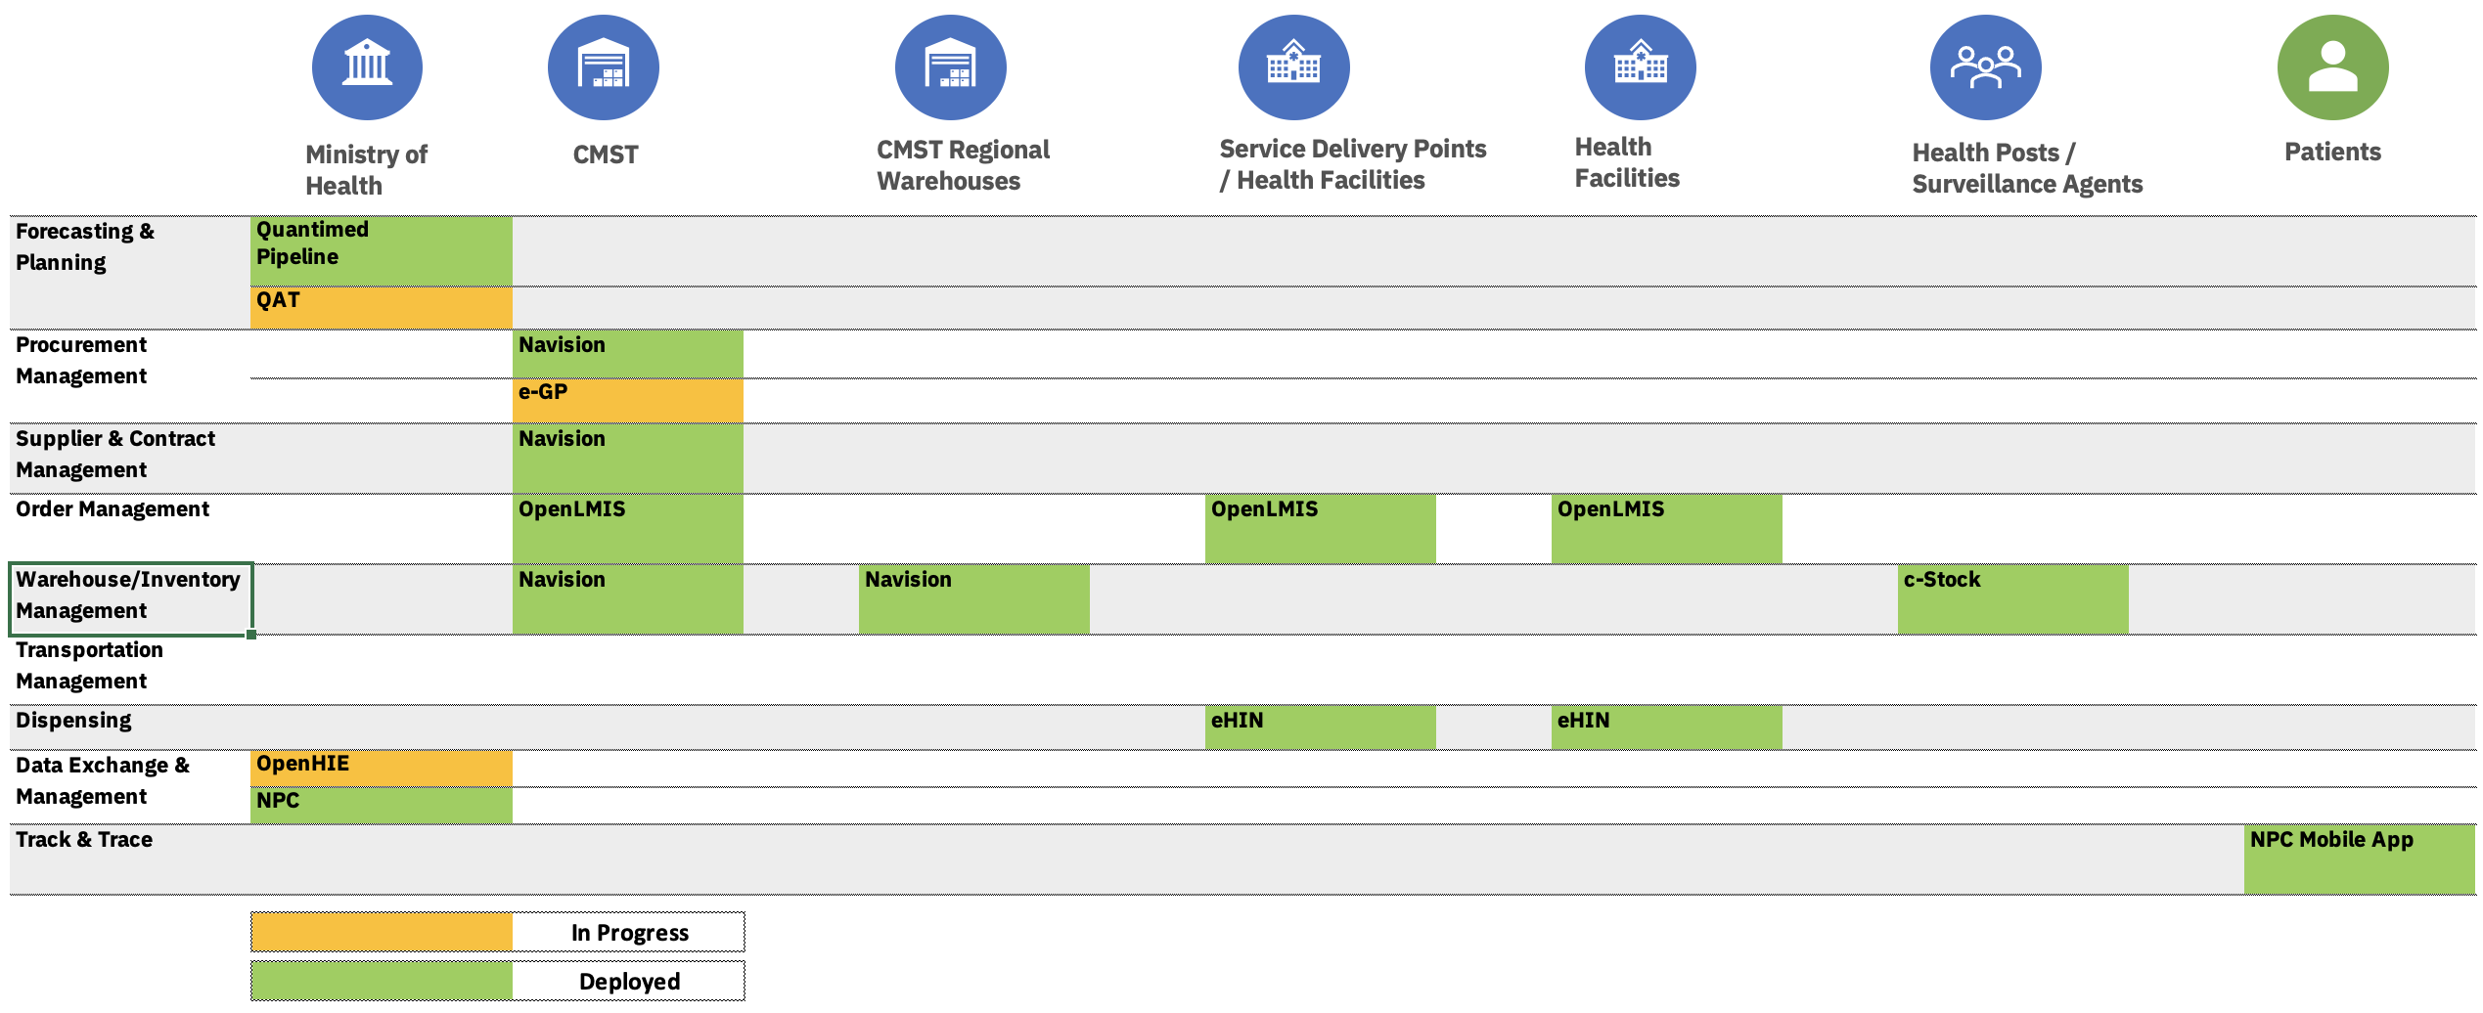
Current DSC Landscape
8

Slide 9
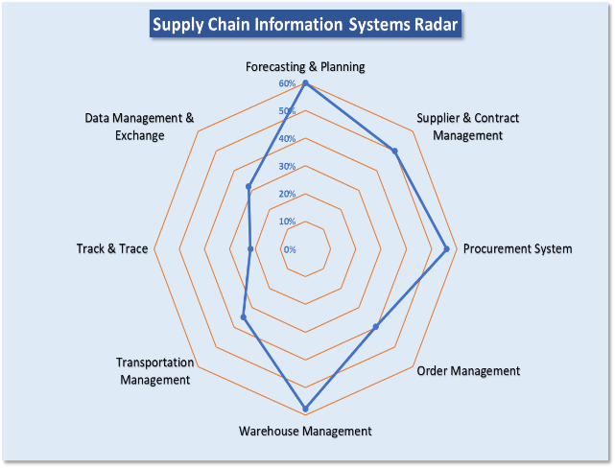
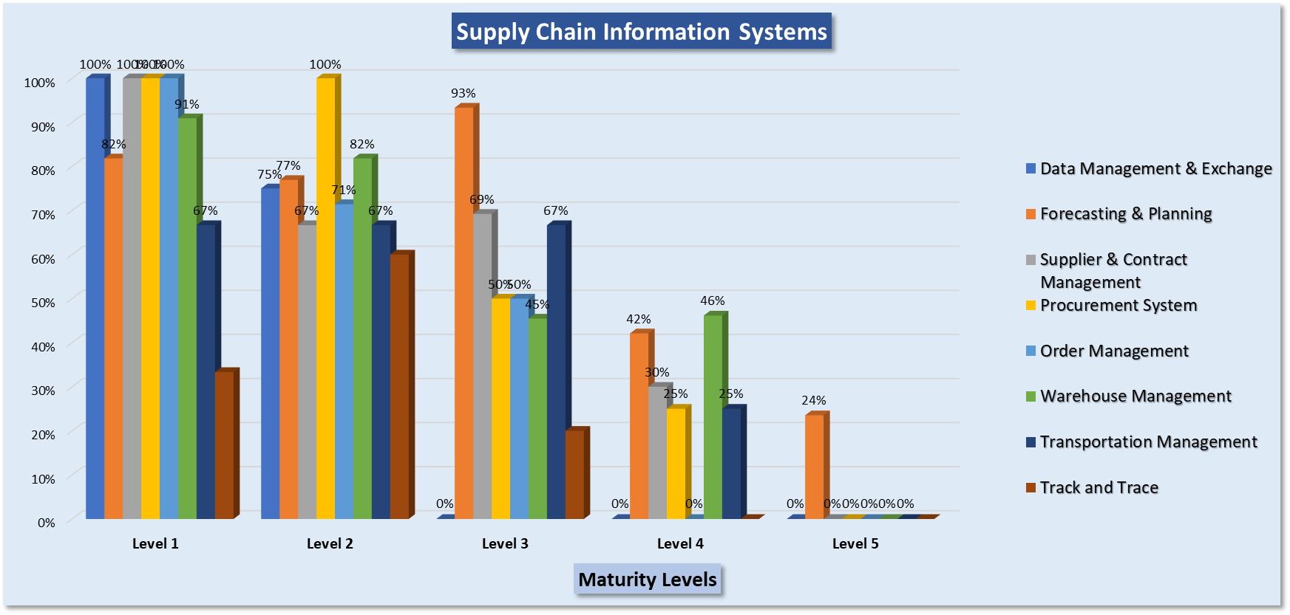
Malawi National DSC Assessment
Key Observations
Forecasting and planning involves manual operations
Suppliers and contracts are managed manually
Procurement is done through well-established processes and will be done through electronic government procurement (e-GP) once operational
No electronic solution implemented to support order submission from customers (hospitals, etc.) and integration to Navision at Central Medical Stores Trust (CMST)
Mainly paper-based manual operation in CMST warehouse; no real-time data captured into Navision
9

Slide 10

Gaps andd Opportunities for Digital Supply Chain:
Review of Existing Strategy Documents
Digital Health Document
Gaps and Opportunities
Monitoring, Evaluation & Health Information Systems Strategy 2017-2022
Recognizes the challenges with health information systems (HISs), such as lack of interoperability, data quality issues, and misaligned IT implementation activities
A key objective is to make high-quality data available for decision-making
  Supply chain data are key to complementing HIS data to improve decision-making and monitoring
While this strategy is focused on HISs, opportunities exist where supply chain systems can complement and contribute to data that will further enhance decision-making
Information systems-related sub-strategies, such as expansion of DHIS2 and interoperability of HIS, can benefit from alignment and coordination/interoperability with supply chain systems. Such triangulated data can provide a holistic view of the health ecosystem, enabling better decisions and enhanced services to patients.
10

Slide 11

Gaps & Opportunities for Digital Supply Chain-
Review of Existing Strategy Documents
Digital Health Document
Gaps and Opportunities
Master Supply Chain Transformation Plan (MSCTP) 2021-2026
Focus areas cover all the key supply chain areas, including information systems
Objectives provide clarity on supply chain areas and results that information system improvements should deliver
Supply chain analytics and business intelligence need to be specifically acknowledged and addressed
  This provides an opportunity to develop an analytics platform using available infrastructure and systems
Information systems architecture should incorporate comprehensive supply chain areas, such as supplier and contracts management and forecasting and planning
11

Slide 12






Supply Chain Challenges, Observed
Operational workload
Clinic
Pharmacy
OpenLMIS
Connectivity Issues
Power Outages
System Issues
No. of Users Trained
Proximity to Work
Increased workload due to the need to manually report data into systems
12

Slide 13
Supply Chain Challenges
Others
Stock-outs
Need for emergency orders and stock transfers by facilities
Overload of manual processes
Manual data entry, leading to errors
Clarity on consumption versus issue, impacting forecasting and distribution
Use of multiple overlapping systems
13

Slide 14
DSC Alignment with National Digital Priorities
Document Reviewed | Priorities | Alignment for DSC Transformation
Monitoring, Evaluation & Health Information Systems Strategy 2017-2022 | Objective 2: Strengthen the health sector’s capacity to use data for decision-making | Implementation of systems based on identified digital priorities - This will enable access to real-time supply chain data that in combination with health data can enhance decision-making
Master Supply Chain Transformation Plan (MSCTP) 2021-2026 | Obj 6.1: To facilitate interoperability including common services and connectivity tools by 2022. Obj 6.3: To develop and deploy the National Supply Chain Information System (NSCIS) for central level supply chain operations (Warehouse Management System/Ordering/Logistics Management System) by 2023 Obj 6.4: To develop and deploy the Facilities’ Supply Chain Information System (FSCIS) by 2025. | Implementation of systems based on identified digital priorities NSCIS and FSCIS, along with interoperability and foundational components, incorporated into an overarching digital supply chain architecture
Health Sector Strategic Plan II (2017-2022) | Objective 5: Generate quality information and make it accessible to all intended users for evidence-based decision-making, through standardized and harmonized tools across all programs | Implementation of systems based on identified digital priorities - This will enable access to real-time supply chain data that in combination with health data can enhance decision-making
14

Slide 15
Draft DSC Strategy

Slide 16
DSC Transformation: Key Objectives
(Proposed, aligning with MSCTP)
#1: Provide genuine high-quality health commodities to patients at the right time, in adequate quantities, at the right place, and at the lowest cost to the system
#2: Continuously improve operational efficiency, resulting in consistent real-time* high-quality data that help supply chain leaders to ensure objective #1
16

Slide 17
*Real-Time versus Reality
DSC Strategy should consider the trade-off between real-time data collection and the workload at lower supply chain levels.
DSC Strategy should provide a gradual transition from manual data-entry/reporting-based processes and systems to system-driven processes to address the workload issue while enabling real-time data capture.
17

Slide 18
Malawi DSC Transformation Vision (Proposed, Example)
18

Slide 19
DSC: Potential Use Case Example 1
19

Slide 20
DSC: Potential Use Case Example 2
20

Slide 21
Supporting Priorities
People
  Leadership
  Workforce capacity
Policy
  Policy framework
  Contractual framework
Governance
  Data
  Process
  Technology
21

Slide 22
Governance Model (Suggested)
DSC Technical Working Group
Executive Chairperson MOH - HTSS
Secretary
MOH
DHD
PMRA
CMST
Other
Technical Representatives
Donors
Implementation Partners
SMOs
Private Sector
Partner Organizations
DSC Technical Working Group – Governance Topics
Data
Process
Technology
Risk
Data Needs Identification
SC Process Formulation & Reviews
Enterprise Architecture Reviews
DSC Risk Management
Data Quality Reviews
Regulatory Compliance
DSC Policies
Risk Identification & Mitigation
Data Exchange Policies
Process Improvements
DSC Technology Audits
Risk Monitoring & Reporting
22
Notes:
Review RMS SCM initiative details
Review traceability strategy document

Slide 23
Draft DSC Architecture

Slide 24

Malawi National DSC: Logical Architecture (As-Is as of Feb 2022)
Forecasting & Planning
(QAT - HTSS, QuanTB)
Sourcing
(e-GP - GoM (WIP))
Procurement
(Navision - CMST)
Order Management
(OpenLMIS - HTSS)
Warehouse Management
(Navision - CMST)
Dispensing
(eHIN - HTSS)
Supply Chain Systems
Interoperability Layer - Data Transformation, Data Orchestration and Data Exchange
(OpenHIM –DHD, (WIP))
Product Master Data
(MHPR –CMST / NPC - HTSS)
Master Health Facility Registry
(DHIS2 - MOH)
Supplier Registry
(Navision - CMST)
Foundational Components
24

Slide 25
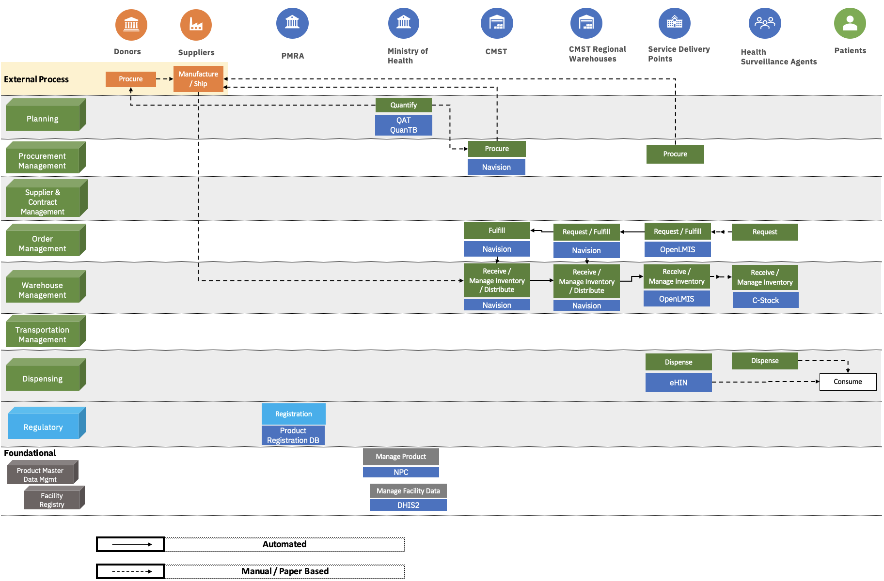
Malawi Supply Chain Process Flow (As-Is as of Feb 2022)
25

Slide 26
Example Digital Priorities Based on DSC Strategy
Foundations
  Product Master Data Management
  Facility Master Data Management
  Supplier Master Data Management
  Terminology Services
Interoperability
  Adoption of Data Standards
Analytics and Business Intelligence
  Traceability and Verification
  Returns and Recalls
Future-proof Technologies
Supply Chain Systems
  Automatic Identification and Data Capture (AIDC)
  Transactional Systems
26

Slide 27







Malawi National DSC: Logical Architecture (To-Be)
Dashboards
Reports
Traceability
Returns & Recalls
Verification
Analytics & Business Intelligence (Options – Navision/DHIS2)
Data Warehouse
Interoperability Layer - Data Transformation, Data Orchestration & Data Exchange
(OpenHIM –DHD, (WIP))
Procurement
(e-GP-GoM)
Warehouse Management
(MACS -CMST)
Supplier & Contract Management
(e-GP - GoM)
Forecasting & Planning
(QAT - HTSS)
Order Management
(OpenLMIS-HTSS)
Transportation Management
(TBD)
Order Management
(OpenLMIS-HTSS)
Inventory Management
(OpenLMIS-HTSS)
Dispensing
(eHIN-HTSS)
National Supply Chain Information Systems (NSCIS)
Facilities’ Supply Chain Information Systems (FSCIS)
Interoperability Layer
Product Item Registration Database - PMRA
Master Health Product Registry –CMST / NPC - HTSS
Master Health Facility Registry (DHIS2 - MOH)
Supplier Registry
(e-GP - GoM)
Terminology Services
Regulatory
Foundational Components
27

Slide 28




To-Be Traceability Architecture
Traceability Solution
Track & Trace Dashboards
GTIN Verification
Batch / Serial# Verification
External
Data Warehouse
Analytics & Business Intelligence
Suppliers
Interoperability Layer
Transaction
& Event Data
Product
Master Data
Track & Trace
National Product Catalog
Verification
Verification
Donors
Transaction & Event Data
Product Item Registration Database
Procurement
WMS
OMS
Transportation Management System
Dispensing
Other Global Partners
Regulatory
System
Transactional Systems
Patients
28

Slide 29
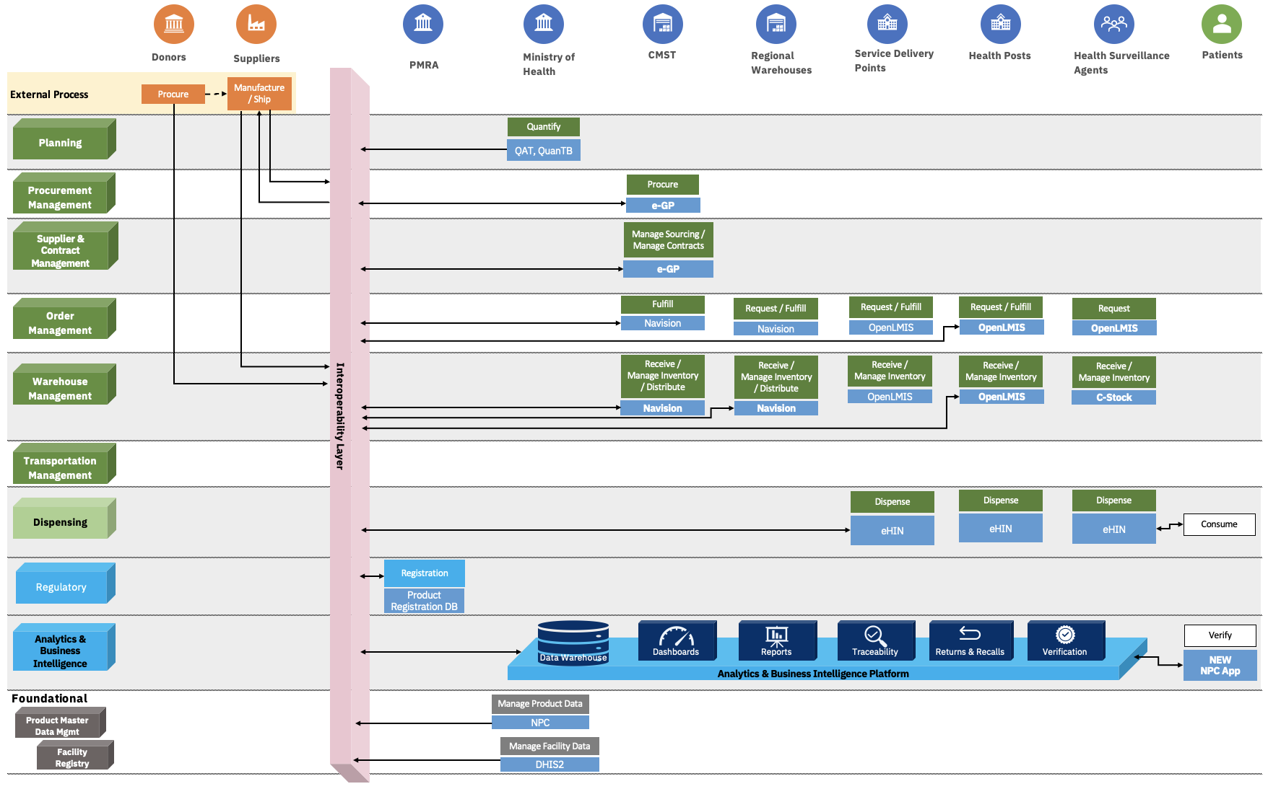
Malawi Supply Chain Process Flow (To-Be)
29

Slide 30
Digital Health Ecosystem: Logical Architecture (To-Be)
Dashboards
Reports
Traceability
Returns & Recalls
Verification
Analytics & Business Intelligence
Data Warehouse
Interoperability Layer - Data Transformation, Data Orchestration & Data Exchange
(OpenHIM –DHD, (WIP))
Global
Planning
Supplier & Contract Management
Order Management
Dispensing
Procurement
Warehouse Management
Transportation Management
Health Information Systems
Regulatory Systems
Insurance Systems
Integrated National Supply Chain Information Systems (INSCIS)
Interop
Manufacturers
Interoperability Layer
Product Item Registration Database- PMRA
Master Health Product Registry- CMST / NPC - HTSS
Master Health Facility Registry (DHIS2-MOH)
Supplier Registry
(e-GP-GoM)
Terminology Services
Other Registries
Regulatory
Foundational Components
30

Slide 31
Draft DSC Roadmap (Sample)

Slide 32
Example Implementation Priorities Based on DSC Strategy
High
Medium
Low
Interoperability layer
Foundational components and integration with other systems through interoperability layer
Forecasting and planning
Order and warehouse management
Dispensing
Incremental development of analytics and business intelligence
  SC dashboards
Integration of all operational SC systems through interoperability layer
Automated and integrated procurement
Supplier and contract management
Incremental development of analytics and business intelligence
  Traceability
  Verification
Transportation management
Incremental development of analytics and business intelligence
Returns and recalls
Integration of all SC systems with other ecosystems, such as HIS, through the interoperability layer
Year 1
Year 2
Year 3
Year 4
Subsequent Years
Enables essential SC and foundation systems to interoperate, ensuring a seamless flow of data to facilitate trustworthy delivery of quality products to patients
Automates other essential SC processes and integrates additional systems to expand the amount of real-time data, contributing to better decision-making and enhanced efficiency
Further integrations across digital ecosystem provide an end-to-end holistic view of public health SC and a solid foundation to adopt advanced technologies such as AI & IoT
#1: Provide genuine high-quality health commodities to patients at the right time, in adequate quantities, and the lowest cost to the system
#2: Continuously improve operational efficiency resulting in consistent real-time high-quality data that helps supply chain leaders to ensure objective #1
32

Slide 33
DSC Roadmap: Sample
33

Slide 34
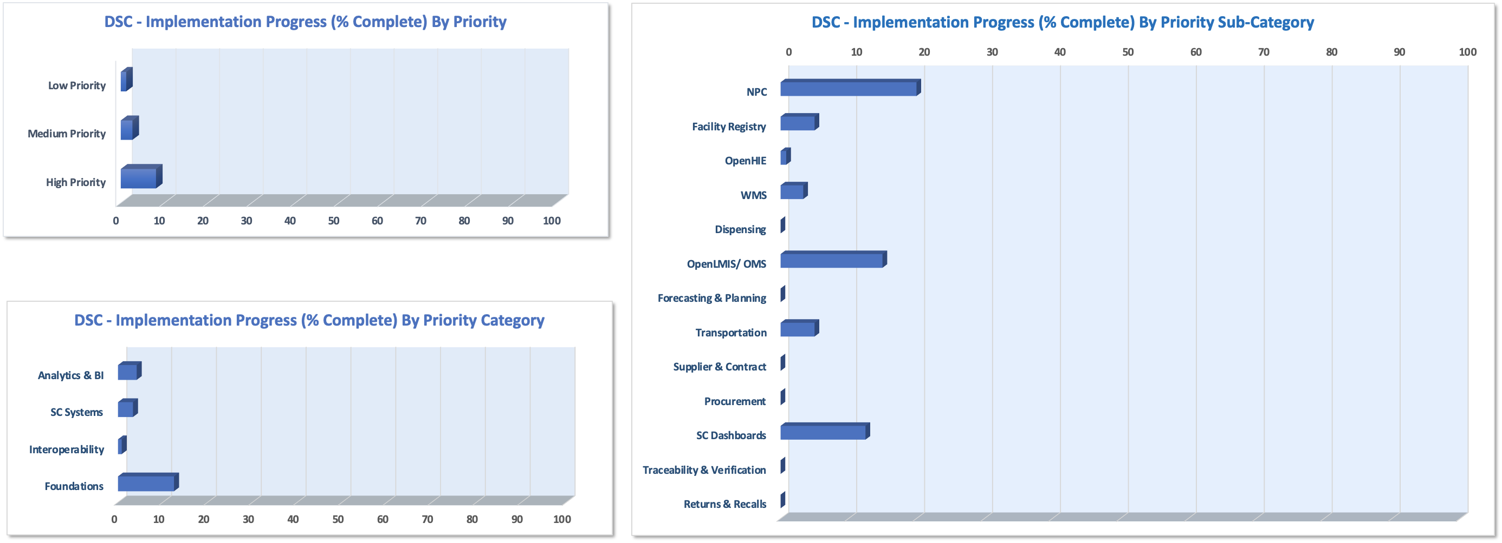
DSC Dashboards (Template)
34

Slide 35
Actionable Considerations
People
  Establish key technical roles to provide technical guidance on implementations and monitor progress
Process
  Adopt a phased approach to implement DSC architecture
  Centralize processes such as sourcing to minimize cost and improve efficiency
  Establish a compliance mechanism to enforce data sharing from supply chain partners to provide key data, including master data and transactional data, such as shipments
Governance
  Establish digital health enterprise architecture governance or working group; ensure regular meetings if working group is already set up
  Establish a formal process to review and approve digital health and DSC initiatives
    Include it as part of MSCTP, HSSP, or other reviews to ensure alignment
  Establish monthly (preferably) or quarterly technical reviews to monitor implementation progress
  Establish quarterly or half yearly as well as end-of-the year senior leadership reviews to monitor overall DSC implementation progress
35
Notes:
Review RMS SCM initiative details
Review traceability strategy document

Slide 36
Actionable Considerations
Technology
  Integrate systems through an interoperability layer so that a system has to integrate only once for a particular transaction or dataset.
  Use open-source systems that have a sizeable active community to eliminate yearly subscription costs and to take advantage of enhancements by the community.
  Ensure that all systems, including SC, HIS, regulatory, insurance, and even private sector, use the same master data from systems, such as NPC/MHPR.
  Enhance and reuse existing systems if they have the required capabilities to meet DSC requirements.
  Reuse existing systems and application platforms to develop solutions for traceability, verification and returns, and recall management.
  Ensure that new systems and enhancements to existing systems consider scalability and long-term sustainability.
  Incorporate off-line capabilities for certain systems where required—for example, mobile applications of warehousing or dispensing systems used by frontline staff and facilities.
  Select and design new systems that can easily adopt GS1 standards in data management and provide sufficient automation in various processes, such as using barcode scanning to receive, store, and move commodities automatically.
36
Notes:
Review RMS SCM initiative details
Review traceability strategy document

Slide 37
DSC Deliverable Submission and Follow-up
Draft DSC S&A Review
  Reviews by relevant technical staff from all stakeholders
  Updates to DSC S&A based on review feedback
DSC S&A – Submission for approval and formalization
  Addressing any questions, if any
  Incorporating feedback, if any
DSC S&A – Implementation
  Updating MOH/HTSS/CMST/PMRA workplans/budgets to incorporate DSC phased implementations
  Monitoring progress of implementations
37

Slide 38
Thank you
38

