Slide 1


Rwanda Health Digital Supply Chain
Strategy and Architecture
March 2022

Slide 2
Agenda
Overview of Digital Supply Chain (DSC)
Rwanda DSC Situation Analyses
Rwanda DSC Strategy
Rwanda DSC Architecture
Rwanda DSC Roadmap
2
Notes:
Review RMS SCM initiative details
Review traceability strategy document

Slide 3
Overview of Digital Supply Chain

Slide 4
What is Digital Supply Chain (DSC)?
DSC helps consistently deliver quality medicines and services on time, at the right place, in the right quantity and at the right cost to patients and end consumers.
DSC ensures this by enabling a digital ecosystem that supports collaborative processes across all systems including supply chain, health management and regulatory.
A digital ecosystem is realized when advanced automation driven supply chain processes are integrated to interoperate with each other and with other ecosystems.
DSC ensures availability of real-time data, providing end-to-end visibility and enhanced decision making.
DONORS
MANUFACTURERS
COMMUNITY HEALTH WORKERS
Digital Ecosystem
PROCURERS
PRIVATE SECTOR
Collaborative
Processes
End to End Visibility
Advanced Digitization
PATIENTS
Data
&
Analytics
SHIPPERS
DPs / SDPs
Transactional Systems
REGULATORS
HEALTH FACILITIES
CENTRAL MEDICAL STORES
4

Slide 5
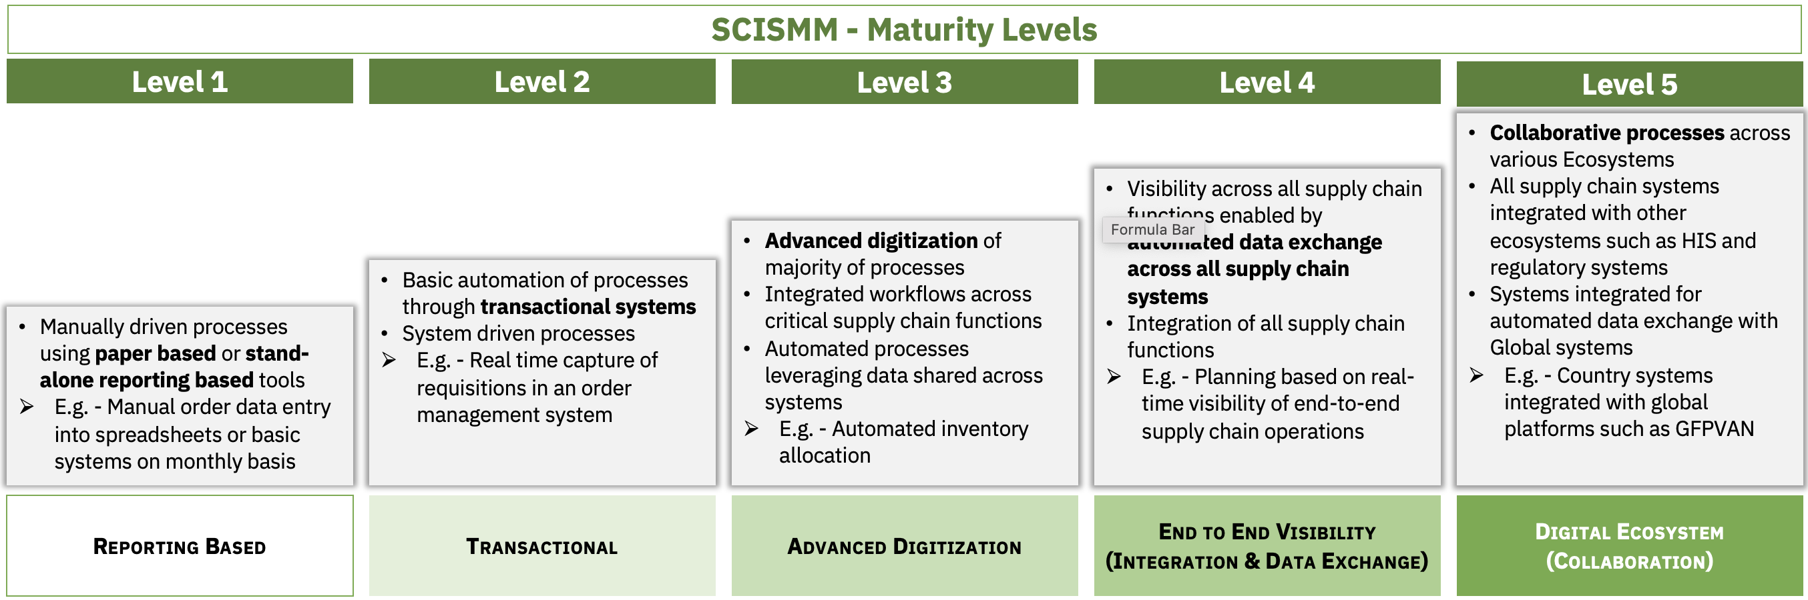
What is Digital Supply Chain?
Realizing DSC through progressively maturing along SCISMM maturity levels

Slide 6
Why do we need Digital Supply Chain?
Real-time data ensures product availability by aligning demand with supply & addressing inventory exceptions quickly
SERVICE
Networked information sharing minimizes product expiries & wastages
End to End Visibility
QUALITY
Advanced Digitization
EFFICIENT SUPPLY CHAIN
Digital Ecosystem
Transactional Systems
Technology driven processes minimizes human errors & improves efficiency
Data
&
Analytics
TRUST
SATISFIED PATIENTS
Collaborative
Processes
Real-time transaction processing enables product verification & ensures authenticity
SAFETY
Progressively adopting automated transactional systems that capture and exchange real-time data with one another, enables collaborative processes and end-to-end visibility. This ultimately improves service, product quality and patient safety.
6

Slide 7
DSC Strategy & Architecture – Activity Objectives
DSC Strategy & Architecture activity will support Rwanda in,
Development of Digital Supply Chain Strategy and Architecture that aligns with existing digital health transformation strategy documents and national priorities
Deliverables will include,
Draft Digital Supply Chain Strategy, highlighting key areas to focus on with a high-level roadmap
Draft Digital Supply Chain Architecture
7

Slide 8
DSC Strategy & Architecture Development - Approach
Analyze
Identify
Prioritize
Define
National Strategy - Rwanda - 2018-2023
DSC Strategy
DSC Vision
DSC Priorities
aligned with other national digital health priorities
DSC Implementation Roadmap
Health & Supply Chain Strategy Documents
Rwanda National HSSP 4
5 Year Strategic Plan 2021-2026 for RMS
Input
Rwanda National Vision & Strategy for Pharmaceutical Traceability
Input
Digital Strategy Document
Rwanda Digital Transformation
DSC Architecture
High Level DSC Reference To-be Architecture
DSC Interoperability with other digital health ecosystems
DSC System Modules
DSC Technical Implementation Roadmap
Supply Chain Systems Landscape
Maturity Assessments
Rwanda-HIS Interoperability Assessment Brief
Input
SCISMM Assessment - 2019
8
Notes:
Review RMS SCM initiative details
Review traceability strategy document

Slide 9

DSC Strategy & Architecture Development – Step 1
ANALYZE
Dependency
MOH – to provide National Digital/eHealth & Architecture documents & any MIS assessment outcomes
INPUT
Review existing digital health or eHealth & traceability strategy documents
Assess current digital supply chain ecosystem using SCISMM
Analyze outputs, if available, from other HIS assessments such as HIS SOCI & HIS interoperability maturity to understand maturity of other SCIS aspects such as interoperability
Review existing HIS and SCIS architecture documents, if available
OUTPUT
MIS assessment outcomes
Existing National digital/eHealth documents
Existing National MIS Architecture documents
Gap Analyses Reports based on,
  review of digital health documents &
  MIS assessment outcomes
9
Notes:
Review RMS SCM initiative details
Review traceability strategy document

Slide 10

DSC Strategy & Architecture Development – Step 2
IDENTIFY
Dependency
None
INPUT
Identify & capture details of existing National HIS & SCIS including data warehouses/lakes, analytical tools & interoperability tools
Identify any ongoing National MIS initiatives
Based on analyses from Step 1, identify areas of immediate, medium-term and long-term digital supply chain improvements
Identify stakeholder groups to engage with to prioritize improvement areas
OUTPUT
Analyses of digital health strategy & architecture documents
Analyses of MIS assessment outcomes
List of short-, medium- and long-term digital supply chain improvement areas
List of stakeholder groups to engage for prioritization
10

Slide 11

DSC Strategy & Architecture Development – Step 3
PRIORITIZE
Dependency
MOH & other stakeholder groups – to provide inputs on prioritization of DSC improvement areas
STTA to Rwanda – Planned for Jul 2021
INPUT
Prioritize the identified DSC improvement areas based on existing National digital strategy and other National IS priorities
Engage with stakeholder groups to discuss the prioritized DSC improvement areas
Based on feedback from stakeholder groups revise and finalize DSC priorities for short-, medium- and long-term
OUTPUT
List of short-, medium- and long-term digital supply chain improvement areas
List of stakeholder groups to engage for prioritization
List of DSC improvement areas prioritized for short-, medium- and long-term
11

Slide 12

DSC Strategy & Architecture Development – Step 4
DEFINE
Dependency
MOH & other stakeholder groups such as RISA, RMS, RBC – Reviews and feedback
INPUT
Based on priorities, develop a draft DSC strategy along with a high-level implementation roadmap for short-, medium- and long-term
Develop a draft DSC architecture
OUTPUT
List of DSC improvement areas prioritized for short-, medium- and long-term
Draft DSC Strategy
Draft DSC Architecture
12

Slide 13
Rwanda DSC Situation Analyses

Slide 14
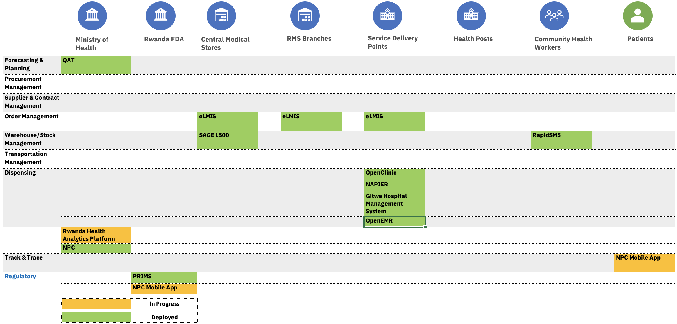
Current DSC Landscape
14
Notes:
Review RMS SCM initiative details
Review traceability strategy document

Slide 15
DSC Assessment
Rwanda has well-established order management processes and system.
While warehouse management processes and system exist with a certain amount of maturity, there is opportunity for improvement.
Other areas such as procurement, forecasting & planning need attention and a long-term roadmap for improvement.
15
Notes:
Review RMS SCM initiative details
Review traceability strategy document

Slide 16
National Digital Health Strategic Plan –
Gaps & Opportunities for Digital Supply Chain
Recognizes the challenges around availability of drugs, the need for supply chain systems and better technologies for more efficient distribution, stock management and quantification
Emphasis on terminology and technology standards to ensure system interoperability
Highlights the need to enhance supply chain systems as part of policy directions and sub-projects
Acknowledges the benefits of supply chain data in DHIS-2, EMR and other health information systems and processes
Highlights opportunities in considering overall supply chain system architecture versus focusing only on eLMIS or WMS
Overarching DSC architecture is aligned with this strategic plan, highlighting the necessary supply chain systems including eLMIS enhancements and how they will interoperate with other health information ecosystems and private sector sub-systems, where applicable
16
Notes:
Review RMS SCM initiative details
Review traceability strategy document

Slide 17
Rwanda Digital Health Transformation –
Gaps & Opportunities for Digital Supply Chain
Focuses on healthcare information systems while supply chain aspects that impact health services, such as planning, procurement and distribution, need consideration
Emphasis on Rwanda HIE that supply chain systems can leverage to share product data relevant to patients across health ecosystems
Integrations such as insurance can benefit from supply chain data to streamline relevant claim processes
HIE can benefit from supply chain specific registries, such as NPC and facility registry, since healthcare systems reference products dispensed to patients
An aligned DSC architecture can highlight synergies with Digital Health architecture, that promotes holistic patient centric health services
17
Notes:
Review RMS SCM initiative details
Review traceability strategy document

Slide 18
DSC Alignment with National Digital Priorities
Document Reviewed | Priorities* | Alignment for DSC Transformation
National Strategy - Rwanda - 2018-2023 | Strengthen the management of critical resources in the health sector, by enhancing the Supply Chain System | Implementation of systems based on SCIS areas identified in section 3.2.2
Rwanda Digital Transformation | Focuses on Health Information Systems (HIS). Opportunities exist where HIS can benefit from supply chain information | Leveraging Rwanda Health Information Exchange to share SC data with HIS to enable a digital health ecosystem
5 Year Strategic Plan 2021-2026 for RMS | Achieve a digitalized system with up to 90% end-to-end data visibility and automation of RMS operations and processes over 5 years | Implementation of systems based on SCIS areas identified in section 3.2.2
Rwanda National Vision & Strategy for Pharmaceutical Traceability | Build and sustain technology to support implementation of traceability and interoperability of health systems for increased data visibility | Implementation of systems based on SCIS areas identified in section 3.2.2 Leveraging Rwanda Health Information Exchange to share SC data across, enabling interoperability and data visibility
18
Notes:
Review RMS SCM initiative details
Review traceability strategy document

Slide 19
Rwanda DSC Strategy

Slide 20
DSC Transformation – Key Objectives (Proposed)
#1 - Provide genuine high-quality pharmaceutical products to patients on time, at the right place, in the right quantity and at the right cost
#2 - Continuously improve operational efficiency resulting in consistent real-time high-quality data that helps supply chain leaders to ensure objective 1
20

Slide 21
DSC Transformation Vision (Proposed)
21

Slide 22
DSC – Use Case 1
22
Notes:
Review RMS SCM initiative details
Review traceability strategy document

Slide 23
DSC – Use Case 2
23
Notes:
Review RMS SCM initiative details
Review traceability strategy document

Slide 24
Supporting Priorities
People
  Leadership
  Workforce Capacity
Policy
  Policy framework
  Contractual framework
Governance
  Data
  Process
  Technology
24
Notes:
Review RMS SCM initiative details
Review traceability strategy document

Slide 25
Governance Model (Suggested)
DSC Technical Working Group
Executive Chairperson MOH
Secretary - RISA
RISA
RSSB
RBC
RMS
Rwanda FDA
Technical Representatives
Donors
Implementation Partners
SMOs
Private Sector
Partner Organizations
DSC Technical Working Group – Governance Topics
Data
Process
Technology
Risk
Data Needs Identification
SC Process Formulation & Reviews
Enterprise Architecture Reviews
DSC Risk Management
Data Quality Reviews
Regulatory Compliance
DSC Policies
Risk Identification & Mitigation
Data Exchange Policies
Process Improvements
DSC Technology Audits
Risk Monitoring & Reporting
25
Notes:
Review RMS SCM initiative details
Review traceability strategy document

Slide 26
Rwanda DSC Architecture

Slide 27
As-Is Logical Architecture
Forecasting & Planning
Warehouse Management
Order Management
Dispensing
Supply Chain Systems
Product Master Data (National Product Catalog)
Facility Registry
Foundational Components
27
Notes:
Review RMS SCM initiative details
Review traceability strategy document

Slide 28
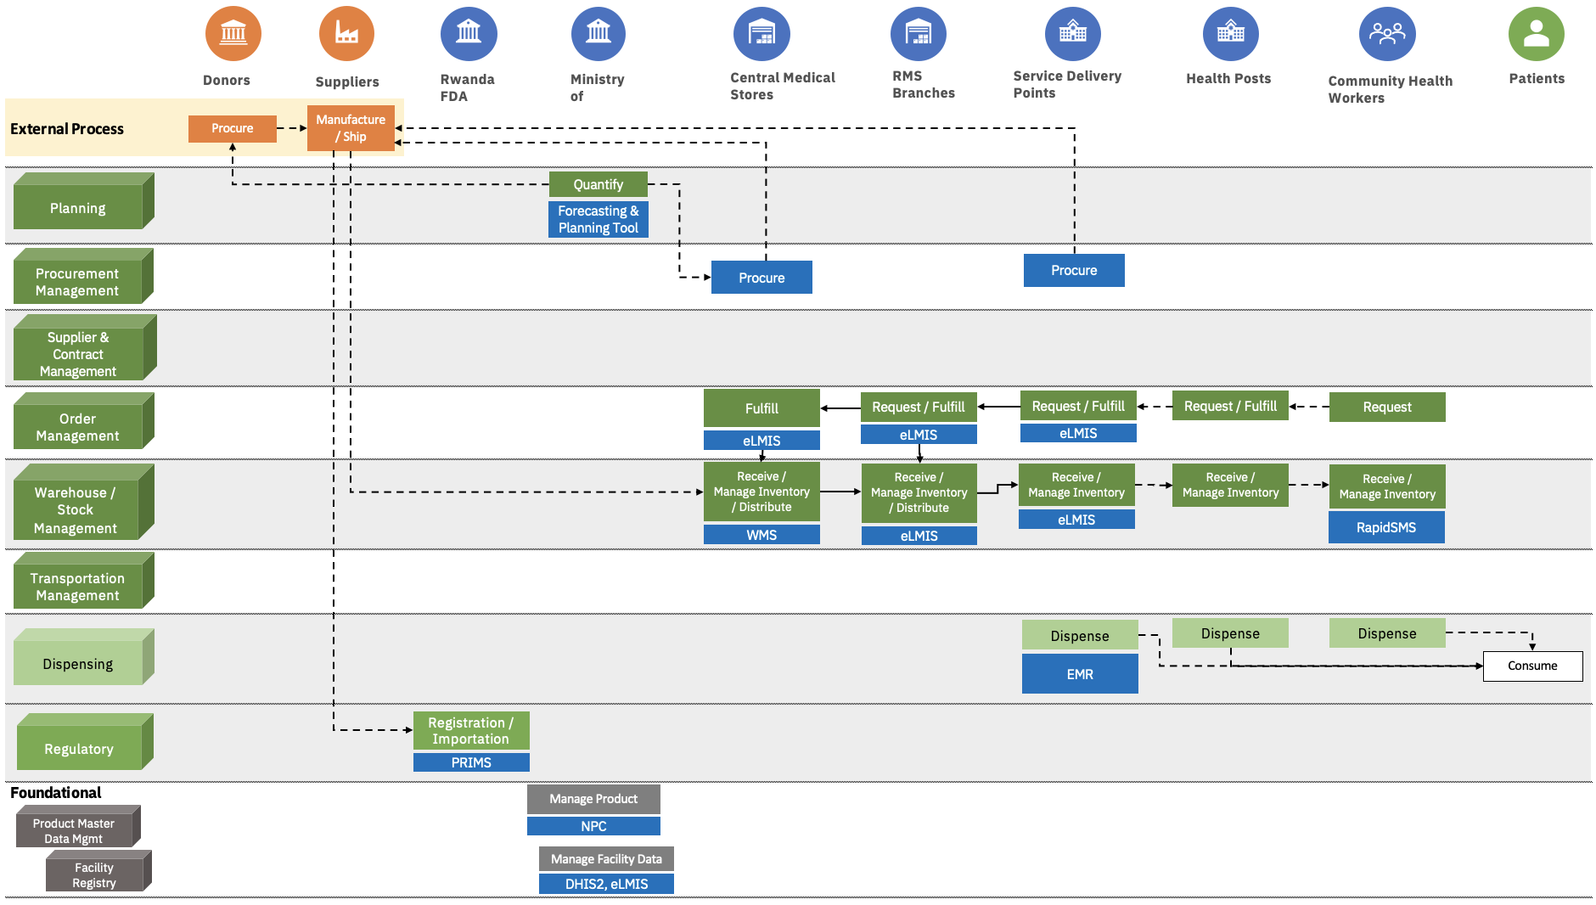
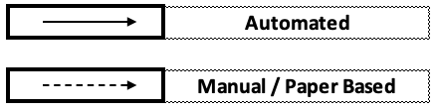
As-Is Process and Data Flow
28
Notes:
Review RMS SCM initiative details
Review traceability strategy document

Slide 29
Digital Priorities
Foundations
  Product Master Data Management
  Facility Master Data Management
  Supplier Master Data Management
  Terminology Services
Interoperability
  Adoption of Data Standards
Supply Chain Systems
  Automatic Identification and Data Capture (AIDC)
  Transactional Systems
29
Notes:
Review RMS SCM initiative details
Review traceability strategy document

Slide 30
Digital Priorities (continued)
Analytics and Business Intelligence
  Traceability and Verification
  Returns and Recalls
Future-Proof Technologies
  IoT
  AI
  Blockchain

Slide 31







DSC - To-Be Logical Architecture
Dashboards
Reports
Traceability
Returns & Recalls
Verification
Analytics & Business Intelligence
Data Warehouse
Data Transformation
Data Orchestration
Data Exchange
Supply Chain Interoperability Layer
Forecasting & Planning
Procurement
Supplier & Contract Management
Order Management
Warehouse Management
Transportation Management
Dispensing
Supply Chain Systems
Supply Chain Interoperability Layer
National Product Catalog
Facility Registry
Supplier Registry
Other Registries
Foundational Components
31
Notes:
Review RMS SCM initiative details
Review traceability strategy document

Slide 32





To-Be Traceability Architecture
Traceability Solution
Track & Trace Dashboards
GTIN Verification
Batch / Serial# Verification
External
Analytics & Business Intelligence
Suppliers
Product
Master Data
National Product Catalog
Interoperability Layer
Private Sector
Transaction
& Event Data
Track & Trace
Verification
Verification
Transaction & Event Data
Donors
Registration/Importation
Procurement
WMS
OMS
Transportation Management System
Dispensing
Other Global Partners
Regulatory
System
Transactional Systems
Patients
32
Notes:
Review RMS SCM initiative details
Review traceability strategy document

Slide 33
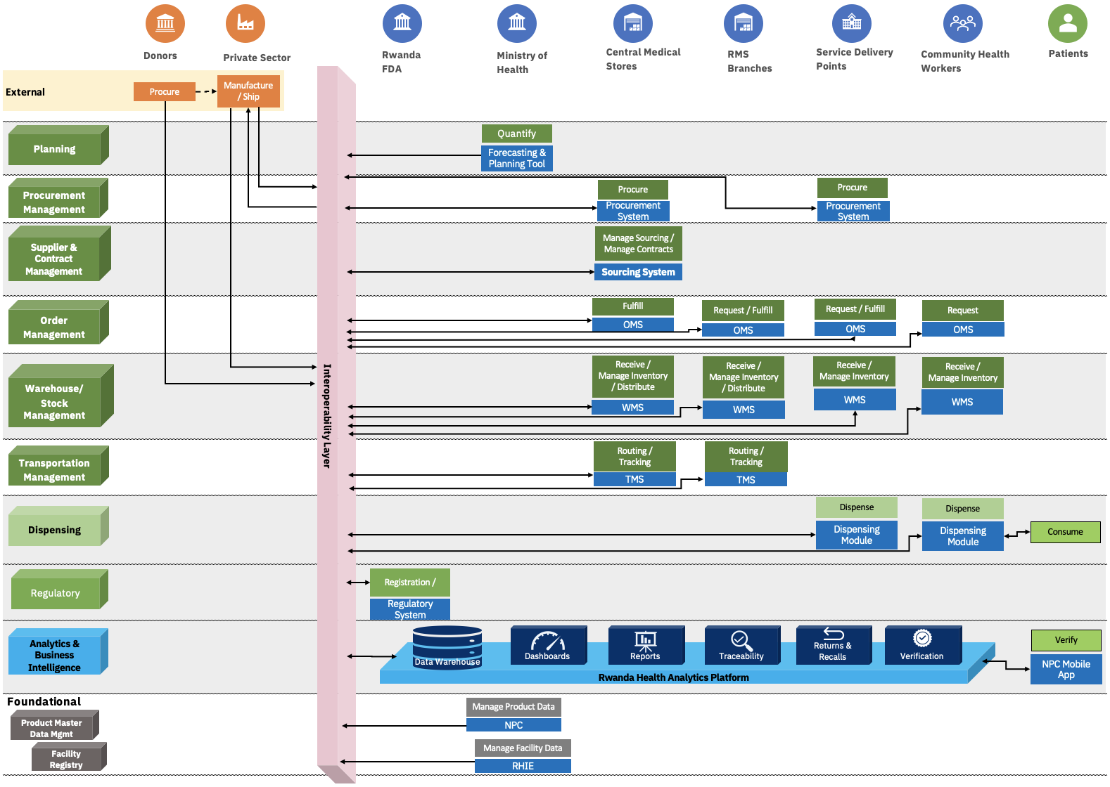
To-Be Process and Data Flow
33
Notes:
Review RMS SCM initiative details
Review traceability strategy document

Slide 34

Digital Health Ecosystem – To-Be Logical Architecture
Dashboards
Reports
Traceability
Returns & Recalls
Verification
Analytics & Business Intelligence
Data Warehouse
Data Transformation
Data Orchestration
Data Exchange
Supply Chain Interoperability Layer
Global
Planning
Supplier & Contract Management
Order Management
Dispensing
Health Information Systems
Regulatory Systems
Insurance Systems
Finance Systems
Procurement
Warehouse Management
Transportation Management
Innterop
Manufacturers
Supply Chain Systems
Global Repositories
Supply Chain Interoperability Layer
Local
Product Master Data
Facility Registry
Supplier Registry
Other Registries
Private Sector
Foundational Components
This is a logical architecture of the digital health ecosystem where supply chain systems interoperate with others such as HIS, Regulatory, Finance and Insurance.
34
Notes:
Review RMS SCM initiative details
Review traceability strategy document

Slide 35
Rwanda DSC Roadmap

Slide 36
DSC Implementation Priorities
Phase 1
Phase 2
Phase 3
Interoperability Layer
Foundational components and integration with other systems through Interoperability Layer
Forecasting & Planning
Warehouse Management
Dispensing
Incremental development of Analytics and Business Intelligence
  SC Dashboards
Integration of all operational SC systems through Interoperability Layer
Procurement
Supplier and Contract Management
Incremental development of Analytics and Business Intelligence
  Traceability
  Verification
Transportation Management
Incremental development of Analytics and Business Intelligence
Returns and Recalls
Integration of all SC systems with other ecosystems such as HIS, through the Interoperability Layer
Year 1
Year 2
Year 3
Year 4
Subsequent Years
Enables essential SC & foundation systems to interoperate ensuring seamless flow of data to facilitate trustworthy delivery of quality products to patients
Automates other essential SC processes & integrates additional systems to expand the amount of real-time data contributing to better decision-making & enhanced efficiency
Further integrations across digital ecosystem provides end-to-end holistic view of public health SC & provides solid foundation to adopt advanced technologies such as AI & IoT
#1 - Provide genuine high-quality pharmaceutical products to patients on time, at the right place and in the right quantity
#2 - Continuously improve operational efficiency resulting in consistent real-time high-quality data that helps supply chain leaders to ensure objective #1
36

Slide 37
DSC Roadmap – Example For Reference
Phase 3
Phase 2
Phase 1
5 Year Phased Implementation Approach
37

Slide 38
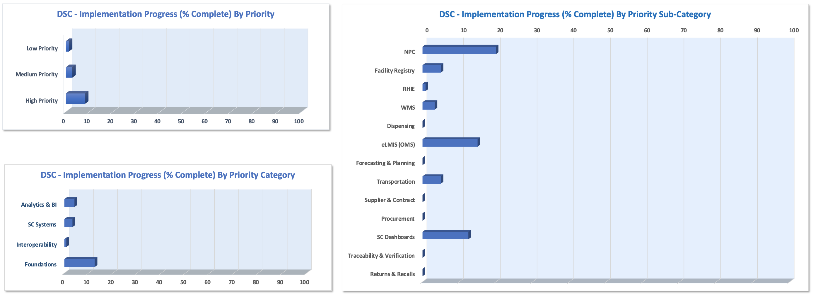
DSC Progress Monitoring Dashboards
38

Slide 39
DSC Progress Monitoring Dashboards (continued)

Slide 40
DSC – Next Steps
DSC S&A – Submission for approval & formalization
  Addressing any questions
  Incorporating feedback
DSC S&A – Implementation
  Updating MOH workplans/budgets to incorporate DSC phased-implementations
  Monitoring progress of implementations
40

Slide 41
Thank you
41

